Slide 1
কিছু কথা
Zero (0) is the additive identity
Zero (1) is the multiplicative identity

Slide 2
কিছু কথা
Y = a + bx
Y = a + bx
Zero (0) is the additive identity
Zero (1) is the multiplicative identity

Slide 3
কিছু কথা
Y = a + bx
Y = a + bx
Zero (0) is the additive identity
Zero (1) is the multiplicative identity

Slide 4
কিছু কথা
Y = a + bx
Y = a + bx
Zero (0) is the additive identity
Zero (1) is the multiplicative identity

Slide 5
কিছু কথা
Y = a + bx
Y = a + bx
Zero (0) is the additive identity
Zero (1) is the multiplicative identity
a ???

Slide 6
কিছু কথা
Y = a + bx
Y = a + bx
Zero (0) is the additive identity
Zero (1) is the multiplicative identity
a ???
Mean or average

Slide 7
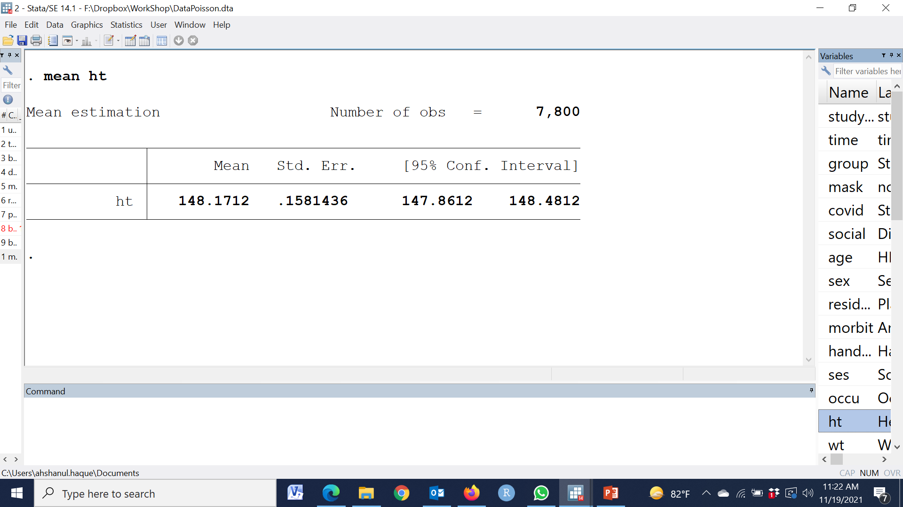
mean ht

Slide 8
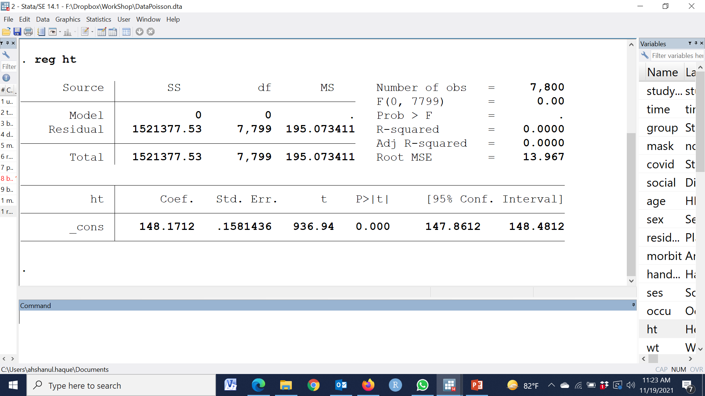
reg ht

Slide 9
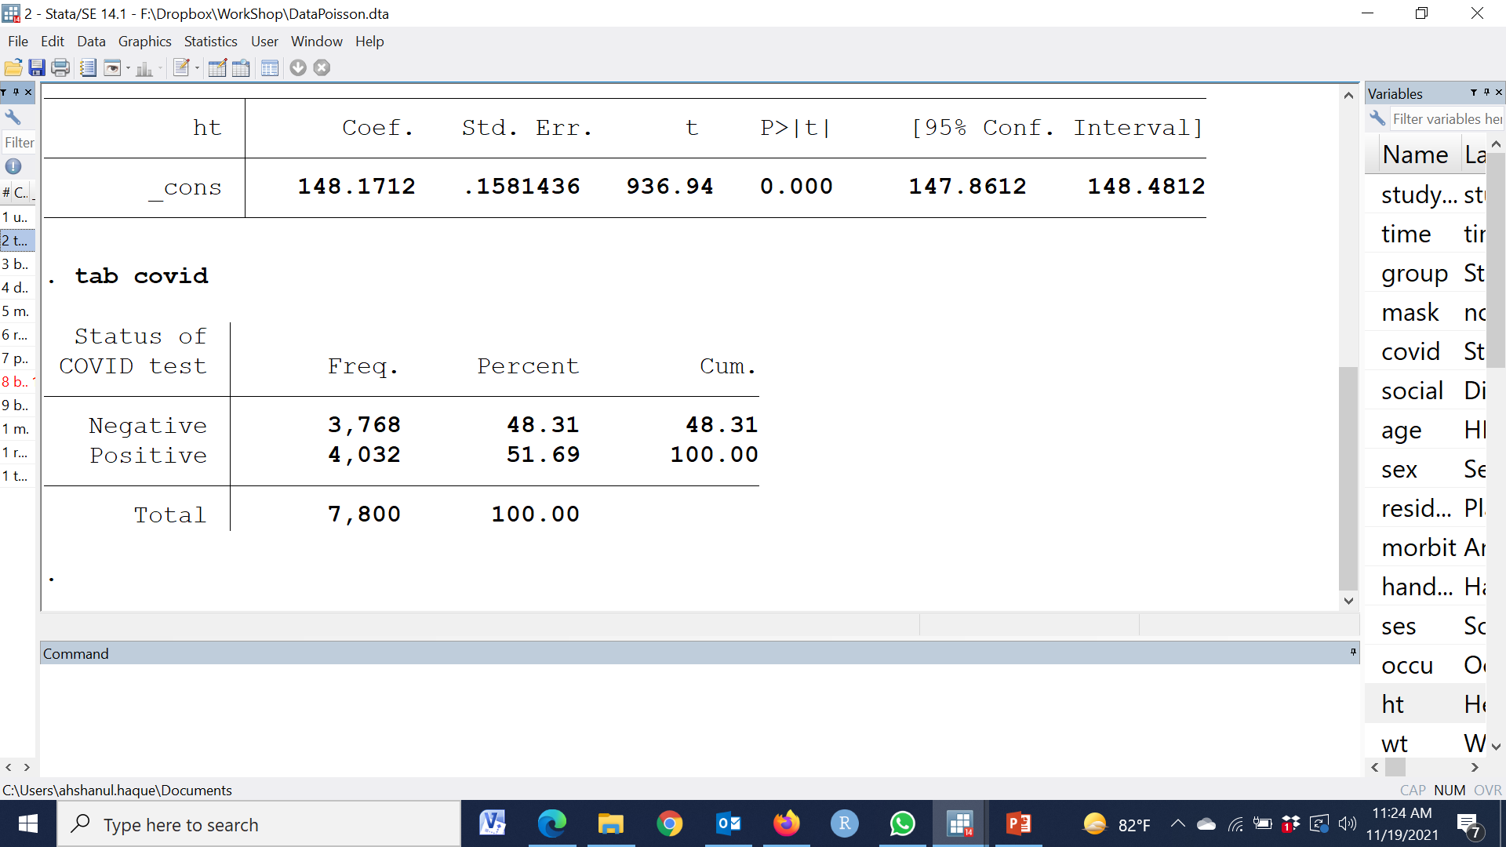
tab covid

Slide 10
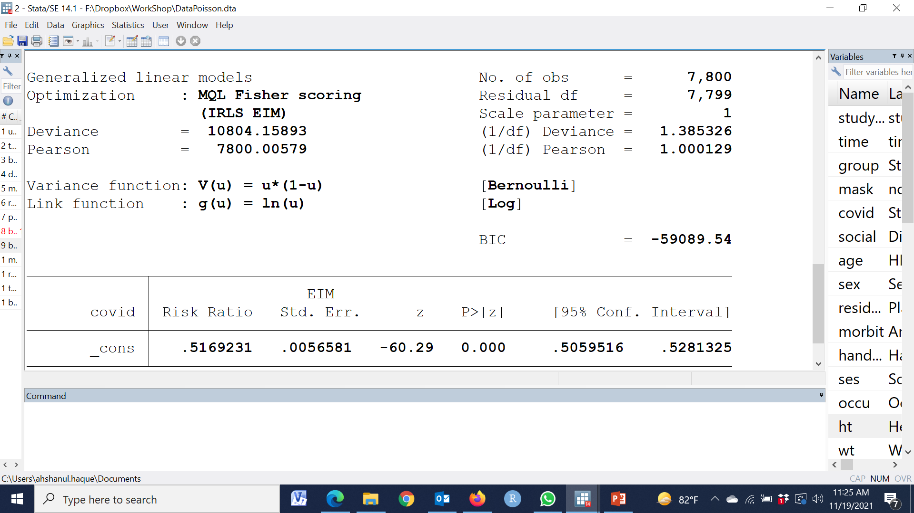
binreg covid, rr

Slide 11
আমি যার উপর মডেল ফিট করতে চাই
Null মডেল সেই জিনিসটাই দেয়

Slide 12
আমি যার উপর মডেল ফিট করতে চাই
Null মডেল সেই জিনিসটাই দেয়
Linear regression | Mean/average
Log-binomial | Proportion/incidence/risk
Poisson | rate
Cox | Hazard

Slide 13
আরও কিছু কথা
Zero (0) is the additive identity
Zero (1) is the multiplicative identity

Slide 14
আরও কিছু কথা
চলুন দশম শ্রেণী থেকে ঘুরে আসি
Zero (0) is the additive identity
Zero (1) is the multiplicative identity

Slide 15
আরও কিছু কথা
log(AB) = log(A) + log(B)
log(A/B) = log(A) - log(B)

Slide 16
Generalized linear model
Poisson and Negative binomial Regression
Facilitated by
Md. Ahshanul Haque Maternal and Child Nutrition
Nutrition and Clinical Services Division
E-mail: ahshanul.haque@icddrb.org

Slide 17


Type of regression
Linear regression
Log linear regression
Logistic regression
Probit regression
Poisson regression
Negative regression
Cross sectional
Cohort
RCT
Case-control
Rate analysis⬄ Count data
Dependent variable is count data

Slide 18
ID | Time | 0 | 1 | 2 | 3 | 4 | 5 | 6 | 7 | 8 | 9 | 10 | 11 | 12 | Duration of exposure | Number of events
1 |  | * | * | * | X | * | * | X | X | * | * | * |  | * | 11 | 3
2 |  | * | * | * |  | X | * | * | * | * | * | * | * | * | 11 | 1
3 |  | * | X | * | * | * | X | X | * | X | X | X | * | X | 12 | 7
4 |  | * | * | * | * | * |  | * | X | * | * | * | X | * | 11 | 2
5 |  | * | * |  | X | * | X | X | X |  | * | X | X | X | 10 | 7
6 |  | * | * | * | * | X | X | * | * | * | X | X | X | X | 12 | 6
7 |  | * | * | * | X | * | * | X | X | * | X |  | * | * | 11 | 4
8 |  | * | X | * | * | * | X | * | * | X |  | X | X | X | 11 | 6
9 |  | * | * | * | X | * | * | X | X | * | * |  | * | * | 11 | 3
10 |  | * | * | * | * |  | X | X | X | X | X | X | X | X | 11 | 8
Total |  |  |  |  |  |  |  |  |  |  |  |  |  |  | 111 | 47

Slide 19
ID | Time | 0 | 1 | 2 | 3 | 4 | 5 | 6 | 7 | 8 | 9 | 10 | 11 | 12 | Duration of exposure | Number of events
1 |  | * | * | * | X | * | * | X | X | * | * | * |  | * | 11 | 3
2 |  | * | * | * |  | X | * | * | * | * | * | * | * | * | 11 | 1
3 |  | * | X | * | * | * | X | X | * | X | X | X | * | X | 12 | 7
4 |  | * | * | * | * | * |  | * | X | * | * | * | X | * | 11 | 2
5 |  | * | * |  | X | * | X | X | X |  | * | X | X | X | 10 | 7
6 |  | * | * | * | * | X | X | * | * | * | X | X | X | X | 12 | 6
7 |  | * | * | * | X | * | * | X | X | * | X |  | * | * | 11 | 4
8 |  | * | X | * | * | * | X | * | * | X |  | X | X | X | 11 | 6
9 |  | * | * | * | X | * | * | X | X | * | * |  | * | * | 11 | 3
10 |  | * | * | * | * |  | X | X | X | X | X | X | X | X | 11 | 8
Total |  |  |  |  |  |  |  |  |  |  |  |  |  |  | 111 | 47
Unexposed
Exposed

Slide 20
ID | Time | 0 | 1 | 2 | 3 | 4 | 5 | 6 | 7 | 8 | 9 | 10 | 11 | 12 | Duration of exposure | Number of events
1 |  | * | * | * | X | * | * | X | X | * | * | * |  | * | 11 | 3
2 |  | * | * | * |  | X | * | * | * | * | * | * | * | * | 11 | 1
3 |  | * | X | * | * | * | X | X | * | X | X | X | * | X | 12 | 7
4 |  | * | * | * | * | * |  | * | X | * | * | * | X | * | 11 | 2
5 |  | * | * |  | X | * | X | X | X |  | * | X | X | X | 10 | 7
6 |  | * | * | * | * | X | X | * | * | * | X | X | X | X | 12 | 6
7 |  | * | * | * | X | * | * | X | X | * | X |  | * | * | 11 | 4
8 |  | * | X | * | * | * | X | * | * | X |  | X | X | X | 11 | 6
9 |  | * | * | * | X | * | * | X | X | * | * |  | * | * | 11 | 3
10 |  | * | * | * | * |  | X | X | X | X | X | X | X | X | 11 | 8
Total |  |  |  |  |  |  |  |  |  |  |  |  |  |  | 111 | 47
Unexposed
Exposed

Slide 21
ID | Time | 0 | 1 | 2 | 3 | 4 | 5 | 6 | 7 | 8 | 9 | 10 | 11 | 12 | Duration of exposure | Number of events
1 |  | * | * | * | X | * | * | X | X | * | * | * |  | * | 11 | 3
2 |  | * | * | * |  | X | * | * | * | * | * | * | * | * | 11 | 1
3 |  | * | X | * | * | * | X | X | * | X | X | X | * | X | 12 | 7
4 |  | * | * | * | * | * |  | * | X | * | * | * | X | * | 11 | 2
5 |  | * | * |  | X | * | X | X | X |  | * | X | X | X | 10 | 7
6 |  | * | * | * | * | X | X | * | * | * | X | X | X | X | 12 | 6
7 |  | * | * | * | X | * | * | X | X | * | X |  | * | * | 11 | 4
8 |  | * | X | * | * | * | X | * | * | X |  | X | X | X | 11 | 6
9 |  | * | * | * | X | * | * | X | X | * | * |  | * | * | 11 | 3
10 |  | * | * | * | * |  | X | X | X | X | X | X | X | X | 11 | 8
Total |  |  |  |  |  |  |  |  |  |  |  |  |  |  | 111 | 47
Unexposed
Exposed

Slide 22
ID | Time | 0 | 1 | 2 | 3 | 4 | 5 | 6 | 7 | 8 | 9 | 10 | 11 | 12 | Duration of exposure | Number of events
1 |  | * | * | * | X | * | * | X | X | * | * | * |  | * | 11 | 3
2 |  | * | * | * |  | X | * | * | * | * | * | * | * | * | 11 | 1
3 |  | * | X | * | * | * | X | X | * | X | X | X | * | X | 12 | 7
4 |  | * | * | * | * | * |  | * | X | * | * | * | X | * | 11 | 2
5 |  | * | * |  | X | * | X | X | X |  | * | X | X | X | 10 | 7
6 |  | * | * | * | * | X | X | * | * | * | X | X | X | X | 12 | 6
7 |  | * | * | * | X | * | * | X | X | * | X |  | * | * | 11 | 4
8 |  | * | X | * | * | * | X | * | * | X |  | X | X | X | 11 | 6
9 |  | * | * | * | X | * | * | X | X | * | * |  | * | * | 11 | 3
10 |  | * | * | * | * |  | X | X | X | X | X | X | X | X | 11 | 8
Total |  |  |  |  |  |  |  |  |  |  |  |  |  |  | 111 | 47
Unexposed
Exposed

Slide 23
ID | Time | 0 | 1 | 2 | 3 | 4 | 5 | 6 | 7 | 8 | 9 | 10 | 11 | 12 | Duration of exposure | Number of events
1 |  | * | * | * | X | * | * | X | X | * | * | * |  | * | 11 | 3
2 |  | * | * | * |  | X | * | * | * | * | * | * | * | * | 11 | 1
3 |  | * | X | * | * | * | X | X | * | X | X | X | * | X | 12 | 7
4 |  | * | * | * | * | * |  | * | X | * | * | * | X | * | 11 | 2
5 |  | * | * |  | X | * | X | X | X |  | * | X | X | X | 10 | 7
6 |  | * | * | * | * | X | X | * | * | * | X | X | X | X | 12 | 6
7 |  | * | * | * | X | * | * | X | X | * | X |  | * | * | 11 | 4
8 |  | * | X | * | * | * | X | * | * | X |  | X | X | X | 11 | 6
9 |  | * | * | * | X | * | * | X | X | * | * |  | * | * | 11 | 3
10 |  | * | * | * | * |  | X | X | X | X | X | X | X | X | 11 | 8
Total |  |  |  |  |  |  |  |  |  |  |  |  |  |  | 111 | 47
Unexposed
Exposed

Slide 24
ID | Time | 0 | 1 | 2 | 3 | 4 | 5 | 6 | 7 | 8 | 9 | 10 | 11 | 12 | Duration of exposure | Number of events
1 |  | * | * | * | X | * | * | X | X | * | * | * |  | * | 11 | 3
2 |  | * | * | * |  | X | * | * | * | * | * | * | * | * | 11 | 1
3 |  | * | X | * | * | * | X | X | * | X | X | X | * | X | 12 | 7
4 |  | * | * | * | * | * |  | * | X | * | * | * | X | * | 11 | 2
5 |  | * | * |  | X | * | X | X | X |  | * | X | X | X | 10 | 7
6 |  | * | * | * | * | X | X | * | * | * | X | X | X | X | 12 | 6
7 |  | * | * | * | X | * | * | X | X | * | X |  | * | * | 11 | 4
8 |  | * | X | * | * | * | X | * | * | X |  | X | X | X | 11 | 6
9 |  | * | * | * | X | * | * | X | X | * | * |  | * | * | 11 | 3
10 |  | * | * | * | * |  | X | X | X | X | X | X | X | X | 11 | 8
Total |  |  |  |  |  |  |  |  |  |  |  |  |  |  | 111 | 47
Unexposed
Exposed

Slide 25
ID | Time | 0 | 1 | 2 | 3 | 4 | 5 | 6 | 7 | 8 | 9 | 10 | 11 | 12 | Duration of exposure | Number of events
1 |  | * | * | * | X | * | * | X | X | * | * | * |  | * | 11 | 3
2 |  | * | * | * |  | X | * | * | * | * | * | * | * | * | 11 | 1
3 |  | * | X | * | * | * | X | X | * | X | X | X | * | X | 12 | 7
4 |  | * | * | * | * | * |  | * | X | * | * | * | X | * | 11 | 2
5 |  | * | * |  | X | * | X | X | X |  | * | X | X | X | 10 | 7
6 |  | * | * | * | * | X | X | * | * | * | X | X | X | X | 12 | 6
7 |  | * | * | * | X | * | * | X | X | * | X |  | * | * | 11 | 4
8 |  | * | X | * | * | * | X | * | * | X |  | X | X | X | 11 | 6
9 |  | * | * | * | X | * | * | X | X | * | * |  | * | * | 11 | 3
10 |  | * | * | * | * |  | X | X | X | X | X | X | X | X | 11 | 8
Total |  |  |  |  |  |  |  |  |  |  |  |  |  |  | 111 | 47
Unexposed
Exposed

Slide 26
ID | Time | 0 | 1 | 2 | 3 | 4 | 5 | 6 | 7 | 8 | 9 | 10 | 11 | 12 | Duration of exposure | Number of events
1 |  | * | * | * | X | * | * | X | X | * | * | * |  | * | 11 | 3
2 |  | * | * | * |  | X | * | * | * | * | * | * | * | * | 11 | 1
3 |  | * | X | * | * | * | X | X | * | X | X | X | * | X | 12 | 7
4 |  | * | * | * | * | * |  | * | X | * | * | * | X | * | 11 | 2
5 |  | * | * |  | X | * | X | X | X |  | * | X | X | X | 10 | 7
6 |  | * | * | * | * | X | X | * | * | * | X | X | X | X | 12 | 6
7 |  | * | * | * | X | * | * | X | X | * | X |  | * | * | 11 | 4
8 |  | * | X | * | * | * | X | * | * | X |  | X | X | X | 11 | 6
9 |  | * | * | * | X | * | * | X | X | * | * |  | * | * | 11 | 3
10 |  | * | * | * | * |  | X | X | X | X | X | X | X | X | 11 | 8
Total |  |  |  |  |  |  |  |  |  |  |  |  |  |  | 111 | 47
Unexposed
Exposed
Study Group | Total Duration of exposure (Person- Times) | Total number of events | Incidence rate | IRR
Unexposed | 55 | 20 | 20/55=36.4% | 1.16
Exposed | 56 | 27 | 27/56=48.2%
Overall | 111 | 47 | 47/111=42.3%

Slide 27
ID | Time | 0 | 1 | 2 | 3 | 4 | 5 | 6 | 7 | 8 | 9 | 10 | 11 | 12 | Duration of exposure | Number of events
1 |  | * | * | * | X | * | * | X | X | * | * | * |  | * | 11 | 3
2 |  | * | * | * |  | X | * | * | * | * | * | * | * | * | 11 | 1
3 |  | * | X | * | * | * | X | X | * | X | X | X | * | X | 12 | 7
4 |  | * | * | * | * | * |  | * | X | * | * | * | X | * | 11 | 2
5 |  | * | * |  | X | * | X | X | X |  | * | X | X | X | 10 | 7
6 |  | * | * | * | * | X | X | * | * | * | X | X | X | X | 12 | 6
7 |  | * | * | * | X | * | * | X | X | * | X |  | * | * | 11 | 4
8 |  | * | X | * | * | * | X | * | * | X |  | X | X | X | 11 | 6
9 |  | * | * | * | X | * | * | X | X | * | * |  | * | * | 11 | 3
10 |  | * | * | * | * |  | X | X | X | X | X | X | X | X | 11 | 8
Total |  |  |  |  |  |  |  |  |  |  |  |  |  |  | 111 | 47
Unexposed
Exposed
Study Group | Total Duration of exposure (Person- Times) | Total number of events | Incidence rate | IRR
Unexposed | 55 | 20 | 20/55=36.4% | 1.16
Exposed | 56 | 27 | 27/56=48.2%
Overall | 111 | 47 | 47/111=42.3%

Slide 28
ID | Time | 0 | 1 | 2 | 3 | 4 | 5 | 6 | 7 | 8 | 9 | 10 | 11 | 12 | Duration of exposure | Number of events
1 |  | * | * | * | X | * | * | X | X | * | * | * |  | * | 11 | 3
2 |  | * | * | * |  | X | * | * | * | * | * | * | * | * | 11 | 1
3 |  | * | X | * | * | * | X | X | * | X | X | X | * | X | 12 | 7
4 |  | * | * | * | * | * |  | * | X | * | * | * | X | * | 11 | 2
5 |  | * | * |  | X | * | X | X | X |  | * | X | X | X | 10 | 7
6 |  | * | * | * | * | X | X | * | * | * | X | X | X | X | 12 | 6
7 |  | * | * | * | X | * | * | X | X | * | X |  | * | * | 11 | 4
8 |  | * | X | * | * | * | X | * | * | X |  | X | X | X | 11 | 6
9 |  | * | * | * | X | * | * | X | X | * | * |  | * | * | 11 | 3
10 |  | * | * | * | * |  | X | X | X | X | X | X | X | X | 11 | 8
Total |  |  |  |  |  |  |  |  |  |  |  |  |  |  | 111 | 47
Unexposed
Exposed
Study Group | Total Duration of exposure (Person- Times) | Total number of events | Incidence rate | IRR
Unexposed | 55 | 20 | 20/55=36.4% | 1.16
Exposed | 56 | 27 | 27/56=48.2%
Overall | 111 | 47 | 47/111=42.3%

Slide 29
ID | Time | 0 | 1 | 2 | 3 | 4 | 5 | 6 | 7 | 8 | 9 | 10 | 11 | 12 | Duration of exposure | Number of events
1 |  | * | * | * | X | * | * | X | X | * | * | * |  | * | 11 | 3
2 |  | * | * | * |  | X | * | * | * | * | * | * | * | * | 11 | 1
3 |  | * | X | * | * | * | X | X | * | X | X | X | * | X | 12 | 7
4 |  | * | * | * | * | * |  | * | X | * | * | * | X | * | 11 | 2
5 |  | * | * |  | X | * | X | X | X |  | * | X | X | X | 10 | 7
6 |  | * | * | * | * | X | X | * | * | * | X | X | X | X | 12 | 6
7 |  | * | * | * | X | * | * | X | X | * | X |  | * | * | 11 | 4
8 |  | * | X | * | * | * | X | * | * | X |  | X | X | X | 11 | 6
9 |  | * | * | * | X | * | * | X | X | * | * |  | * | * | 11 | 3
10 |  | * | * | * | * |  | X | X | X | X | X | X | X | X | 11 | 8
Total |  |  |  |  |  |  |  |  |  |  |  |  |  |  | 111 | 47
Unexposed
Exposed
Study Group | Total Duration of exposure (Person- Times) | Total number of events | Incidence rate | IRR
Unexposed | 55 | 20 | 20/55=36.4% | 1.32
Exposed | 56 | 27 | 27/56=48.2%
Overall | 111 | 47 | 47/111=42.3%

Slide 30
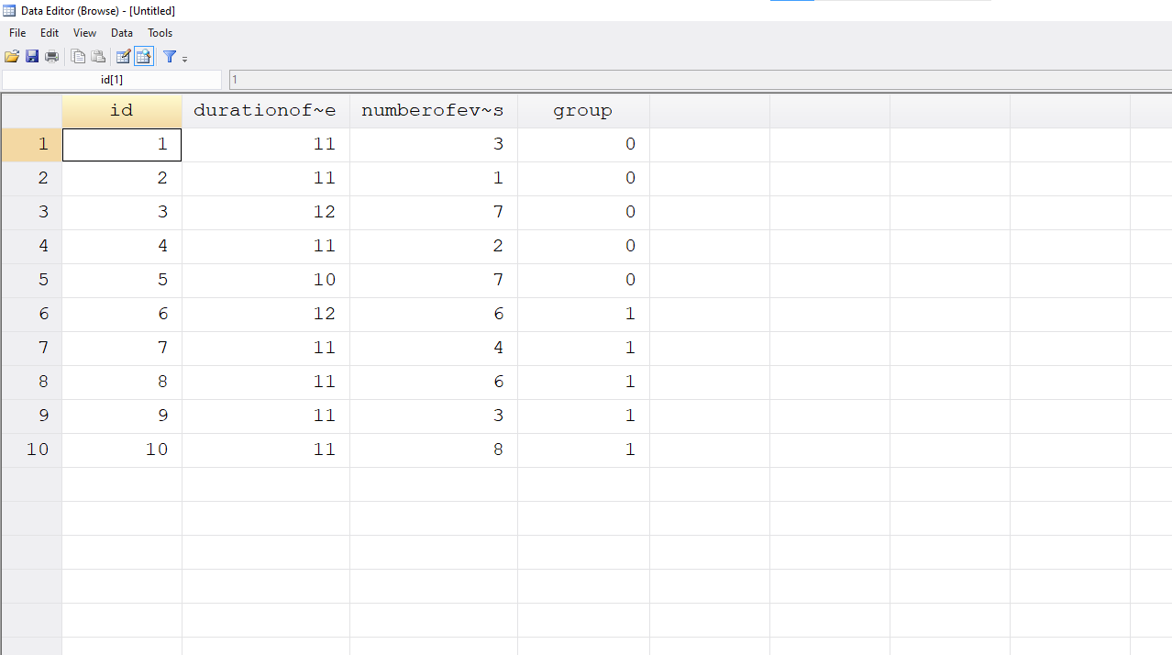

Slide 31
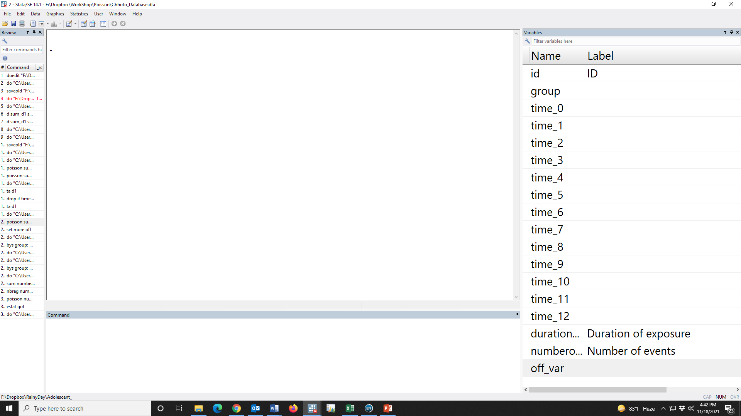

Slide 32
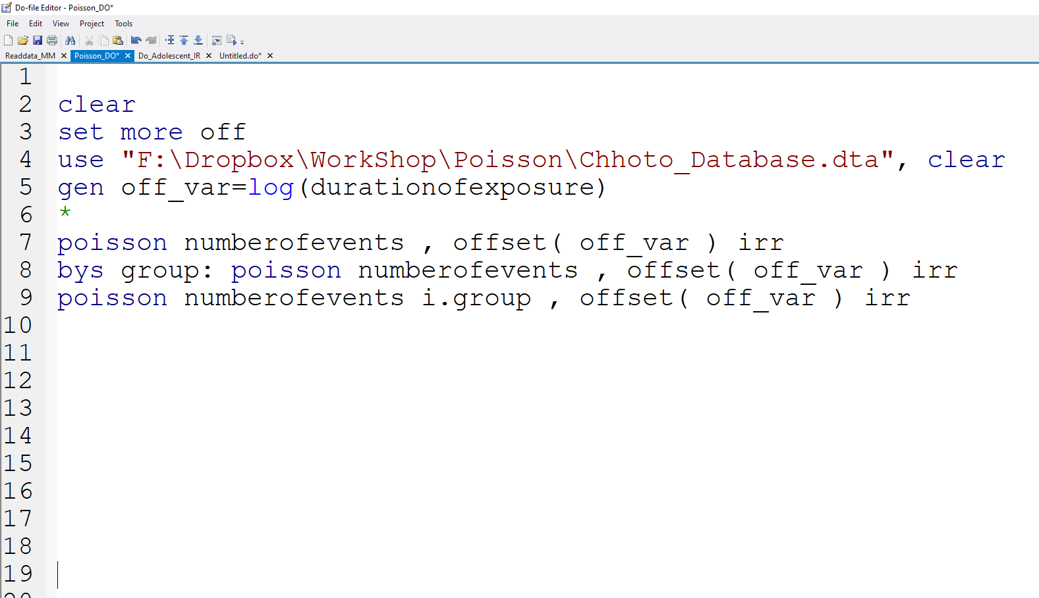

Slide 33
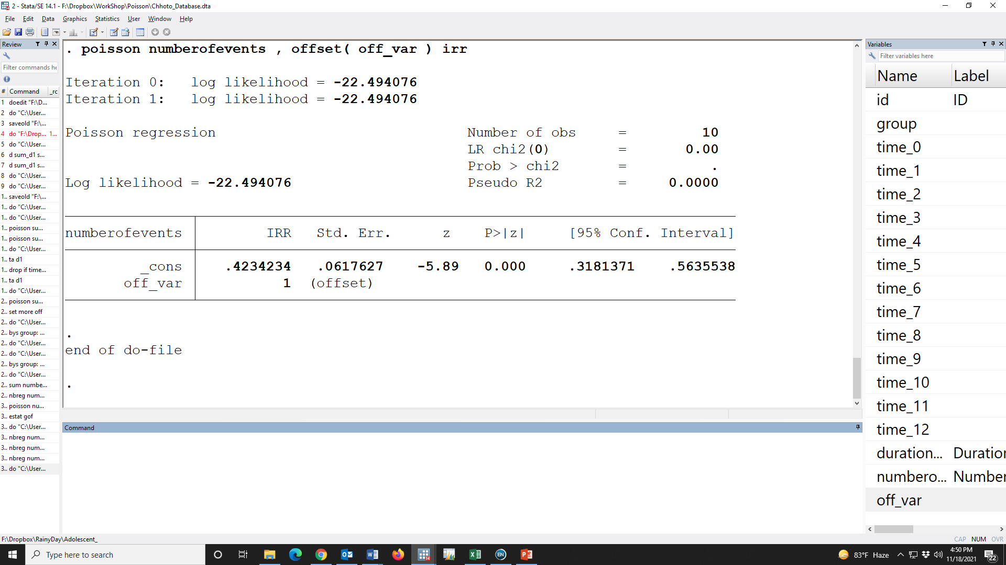

Slide 35
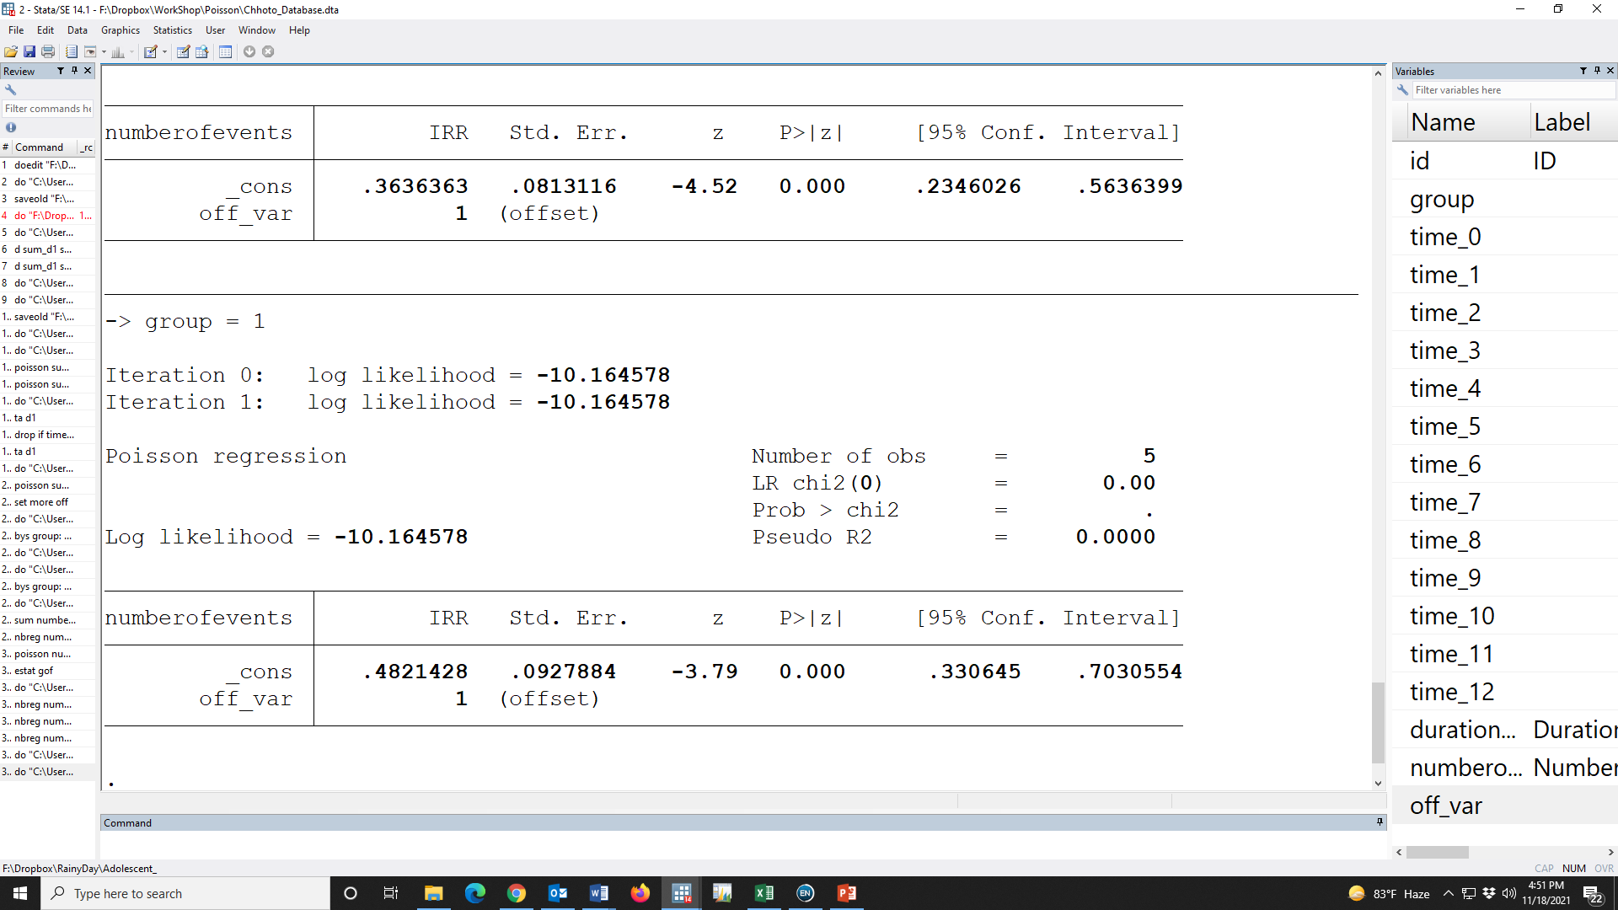

Slide 36
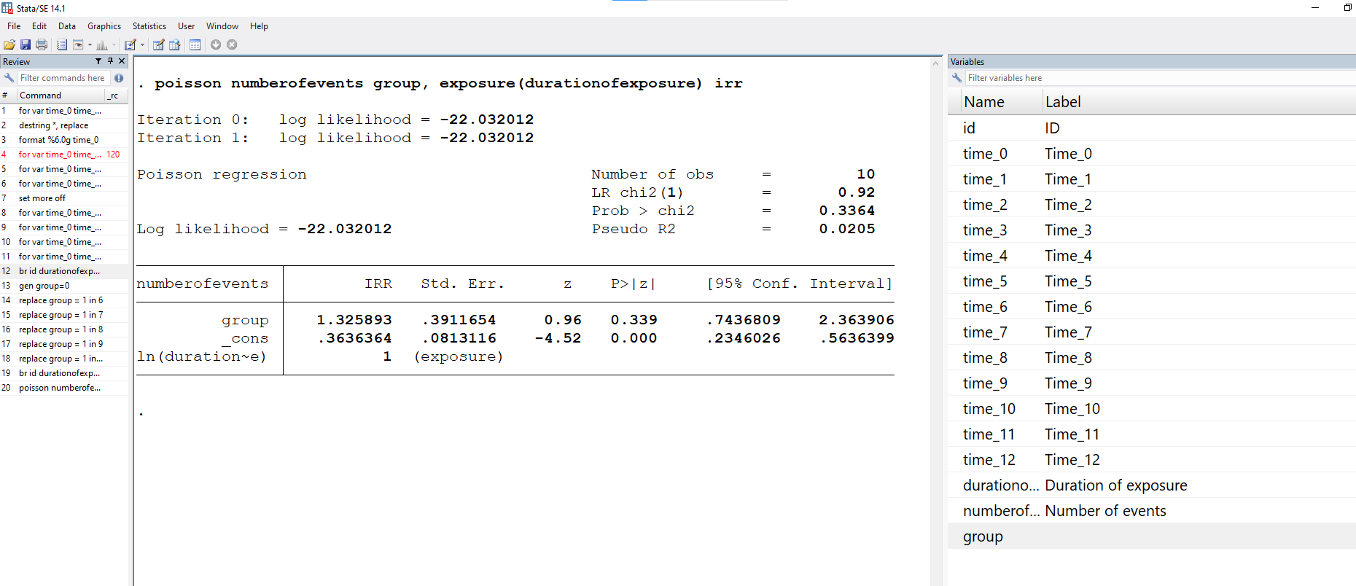

Slide 37
ID | Time | 0 | 1 | 2 | 3 | 4 | 5 | 6 | 7 | 8 | 9 | 10 | 11 | 12 | Duration of exposure | Number of events
1 |  | * | * | * | X | * | * | X | X | * | * | * |  | * | 11 | 3
2 |  | * | * | * |  | X | * | * | * | * | * | * | * | * | 11 | 1
3 |  | * | X | * | * | * | X | X | * | X | X | X | * | X | 12 | 7
4 |  | * | * | * | * | * |  | * | X | * | * | * | X | * | 11 | 2
5 |  | * | * |  | X | * | X | X | X |  | * | X | X | X | 10 | 7
6 |  | * | * | * | * | X | X | * | * | * | X | X | X | X | 12 | 6
7 |  | * | * | * | X | * | * | X | X | * | X |  | * | * | 11 | 4
8 |  | * | X | * | * | * | X | * | * | X |  | X | X | X | 11 | 6
9 |  | * | * | * | X | * | * | X | X | * | * |  | * | * | 11 | 3
10 |  | * | * | * | * |  | X | X | X | X | X | X | X | X | 11 | 8
Total |  |  |  |  |  |  |  |  |  |  |  |  |  |  | 111 | 47
Unexposed
Exposed
Study Group | Total Duration of exposure (Person- Times) | Total number of events | Incidence rate | IRR
Unexposed | 55 | 20 | 20/55=36.4% | 1.32
Exposed | 56 | 27 | 27/56=48.2%
Overall | 111 | 47 | 47/111=42.3%

Slide 38
Outcome indicators | Incidence rate per 100 Child-months (95% CI) |  |  | IRR (95% CI)
 | Exposed | Unexposed | Overall
Disease - 1 | 48.2 (33.1, 70.3) | 36.4 (23.5, 56.4) | 42.3 (31.8, 56.3) | 1.32 (0.7, 2.6))
Study Group | Total Duration of exposure (Person- Times) | Total number of events | Incidence rate | IRR
Unexposed | 55 | 20 | 20/55=36.4% | 1.32
Exposed | 56 | 27 | 27/56=48.2%
Overall | 111 | 47 | 47/111=42.3%

Slide 39
Outcome indicators | Incidence rate per 100 Child-months (95% CI) |  |  | IRR (95% CI)
 | Exposed | Unexposed | Overall
Disease - 1 | 48.2 (33.1, 70.3) | 36.4 (23.5, 56.4) | 42.3 (31.8, 56.3) | 1.32 (0.7, 2.6)
Study Group | Total Duration of exposure (Person- Times) | Total number of events | Incidence rate | IRR
Unexposed | 55 | 20 | 20/55=36.4% | 1.32
Exposed | 56 | 27 | 27/56=48.2%
Overall | 111 | 47 | 47/111=42.3%

Slide 40
Outcome indicators | Incidence rate per 100 Child-months (95% CI) |  |  | IRR (95% CI)
 | Exposed | Unexposed | Overall
Disease - 1 | 48.2 (33.1, 70.3) | 36.4 (23.5, 56.4) | 42.3 (31.8, 56.3) | 1.32 (0.7, 2.6)
The incidence rate per 100 child-months of having disease during 1–12 month follow up was 48.2 (95% CI: 33.1, 70.3) in the exposed group whereas the status was 36.4 (95% CI: 23.5, 56.4) in the unexposed group. The incidence rate was 1.32 time in the exposed group compare to the unexposed group. The exposer had no significantly effect on disease-1.

Slide 41
Outcome indicators | Incidence rate per 100 Child-months (95% CI) |  |  | IRR (95% CI)
 | Exposed | Unexposed | Overall
Disease - 1 | 48.2 (33.1, 70.3) | 36.4 (23.5, 56.4) | 42.3 (31.8, 56.3) | 1.32 (0.7, 2.6)
The incidence rate per 100 child-months of having disease during 1–12 month follow up was 48.2 (95% CI: 33.1, 70.3) in the exposed group whereas the status was 36.4 (95% CI: 23.5, 56.4) in the unexposed group. The incidence rate was 1.32 time in the exposed group compare to the unexposed group. The exposer had no significantly effect on disease-1.

Slide 42
Outcome indicators | Incidence rate per 100 Child-months (95% CI) |  |  | IRR (95% CI)
 | Exposed | Unexposed | Overall
Disease - 1 | 48.2 (33.1, 70.3) | 36.4 (23.5, 56.4) | 42.3 (31.8, 56.3) | 1.32 (0.7, 2.6)
The incidence rate per 100 child-months of having disease during 1–12 month follow up was 48.2 (95% CI: 33.1, 70.3) in the exposed group whereas the status was 36.4 (95% CI: 23.5, 56.4) in the unexposed group. The incidence rate was 1.32 time in the exposed group compare to the unexposed group. The exposer had no significantly effect on disease-1.

Slide 43
Another dataset

Slide 44
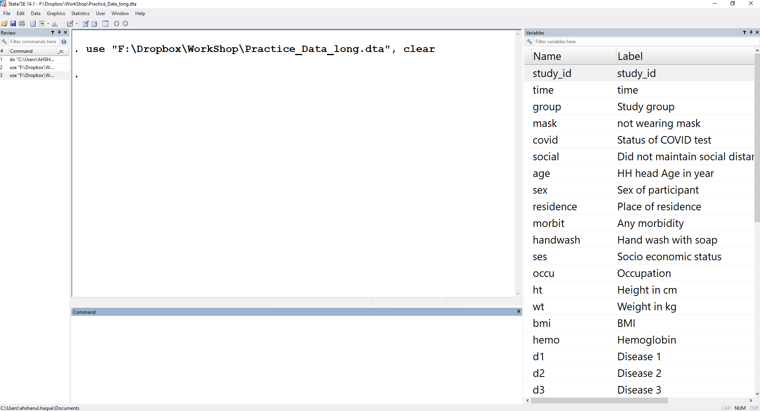

Slide 45
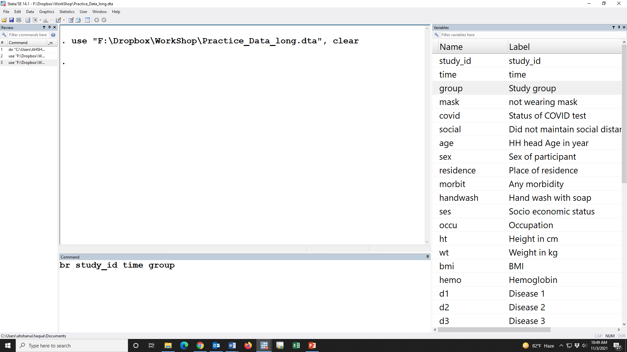

Slide 46
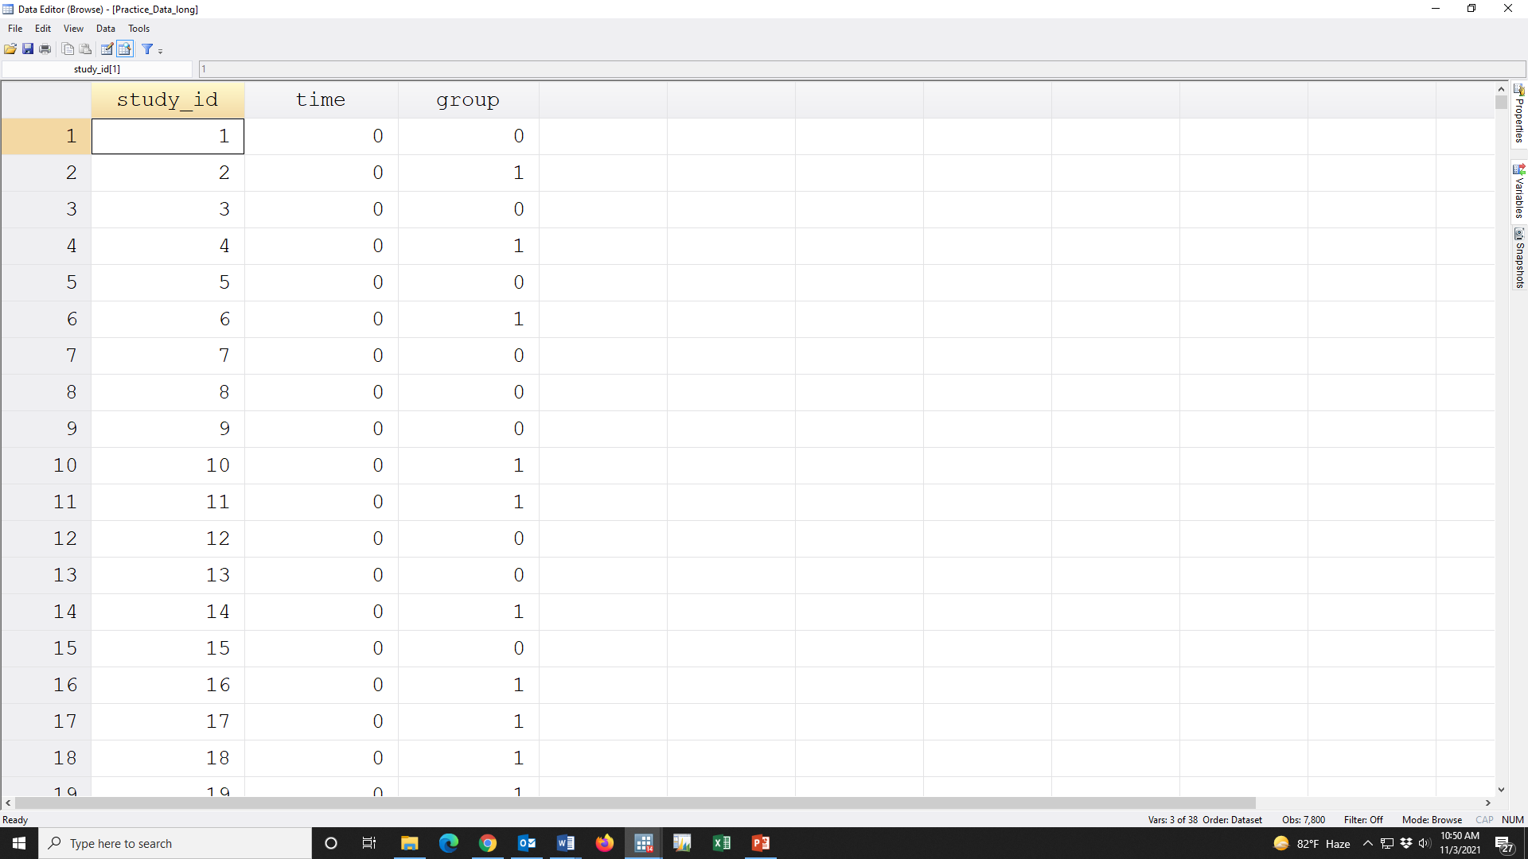

Slide 47
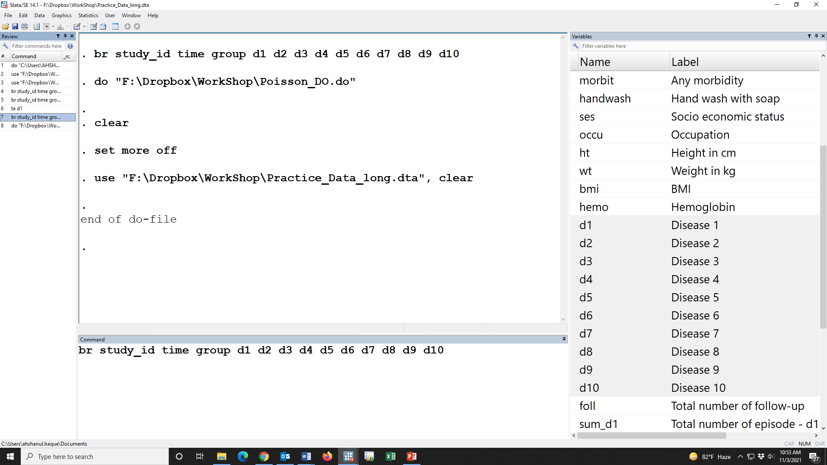

Slide 48


Slide 49
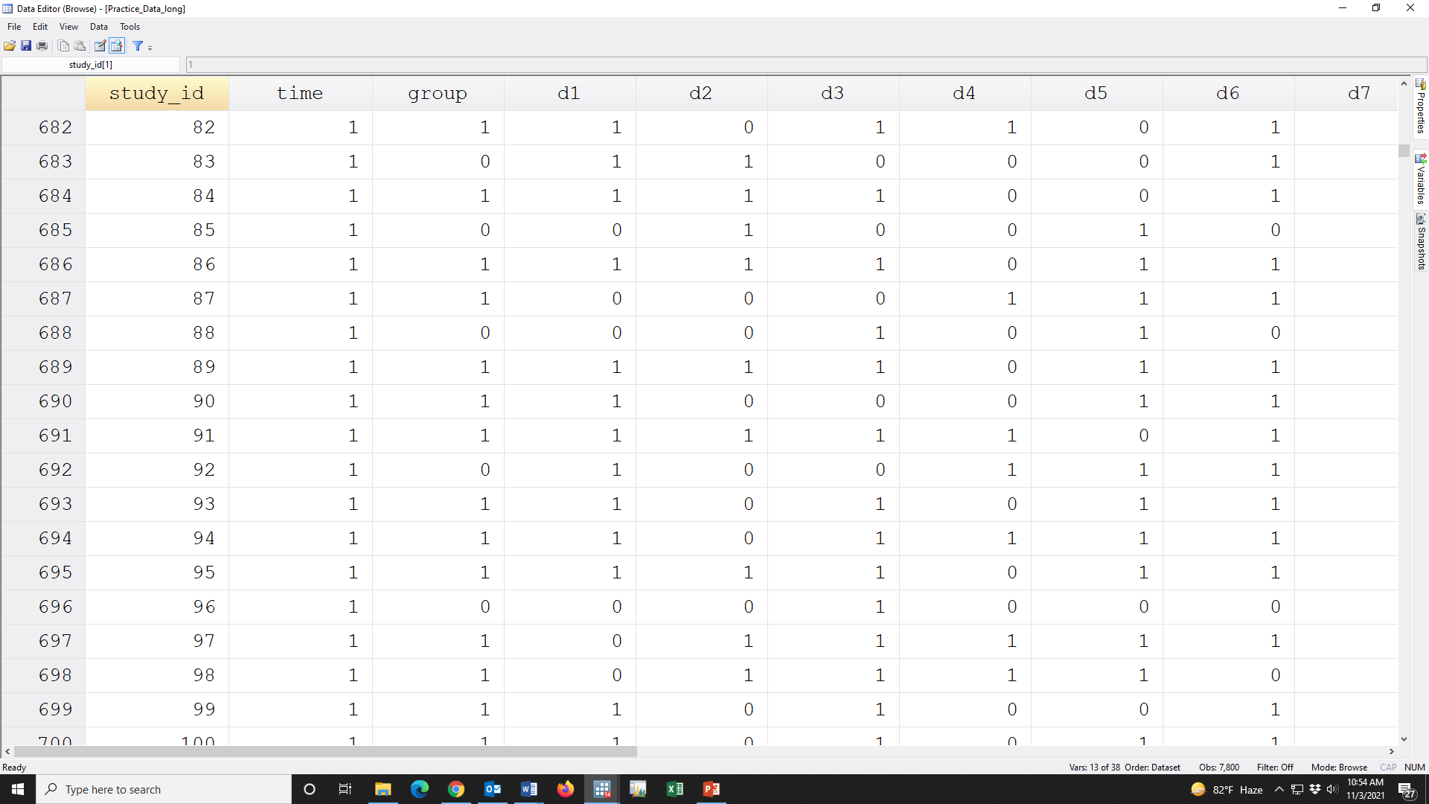

Slide 50


Slide 51
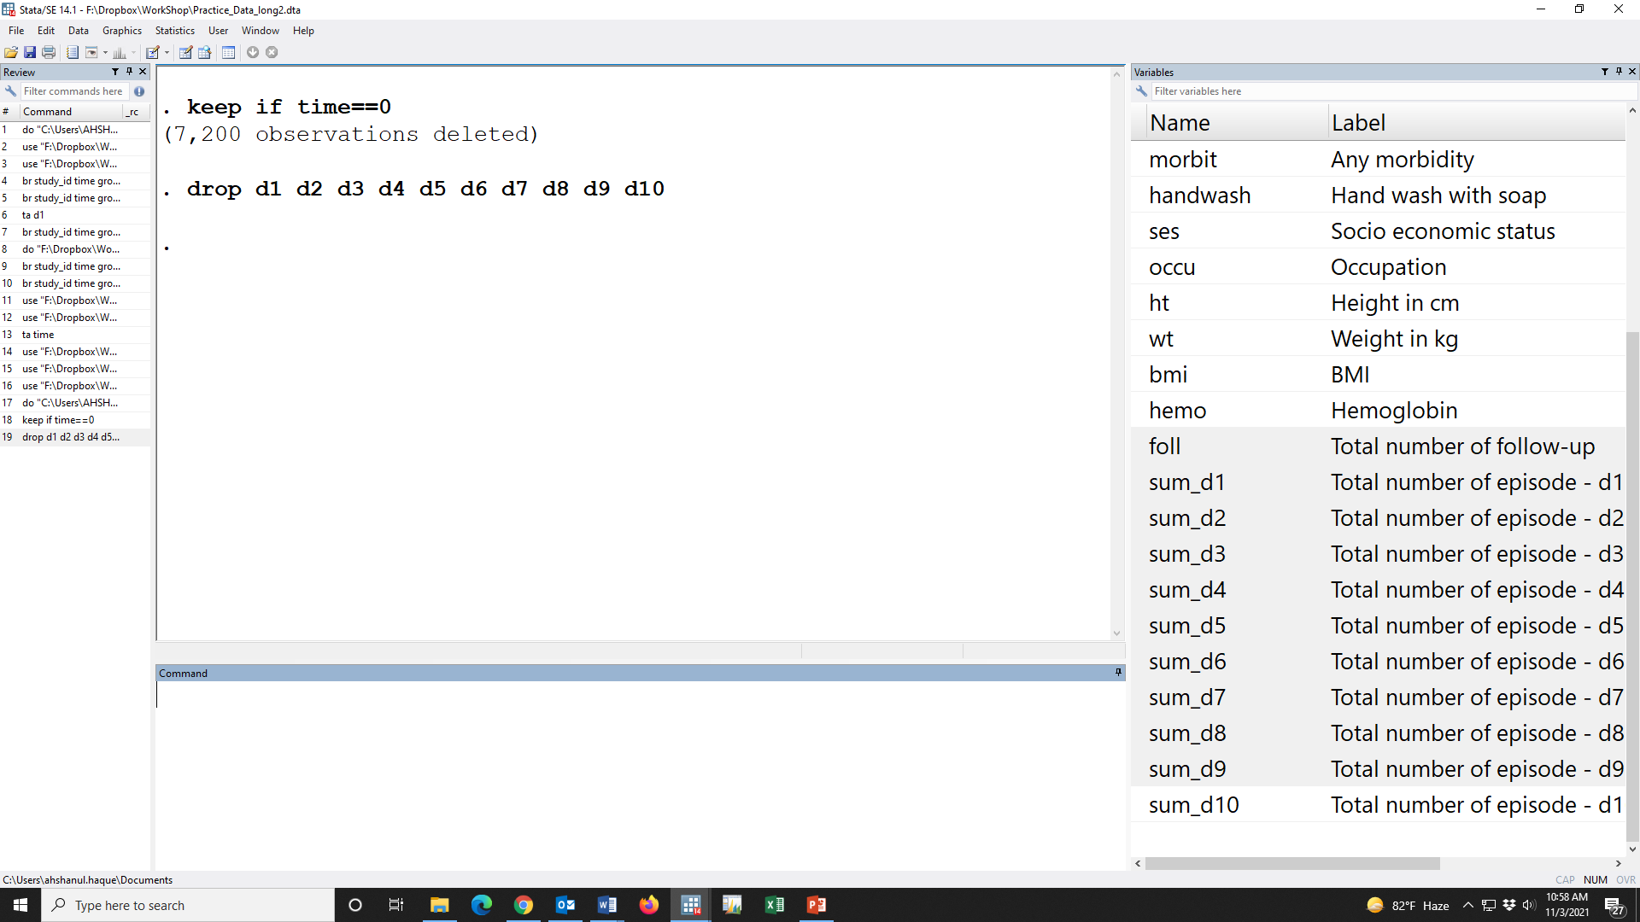

Slide 52
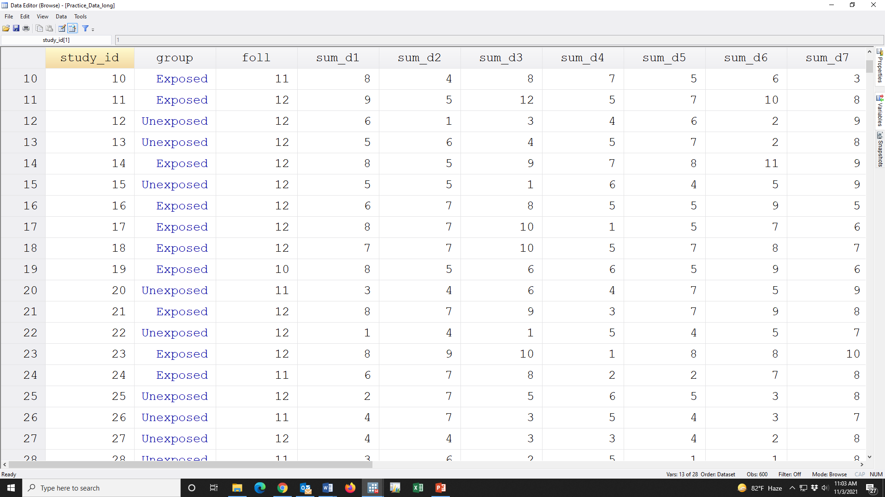

Slide 53
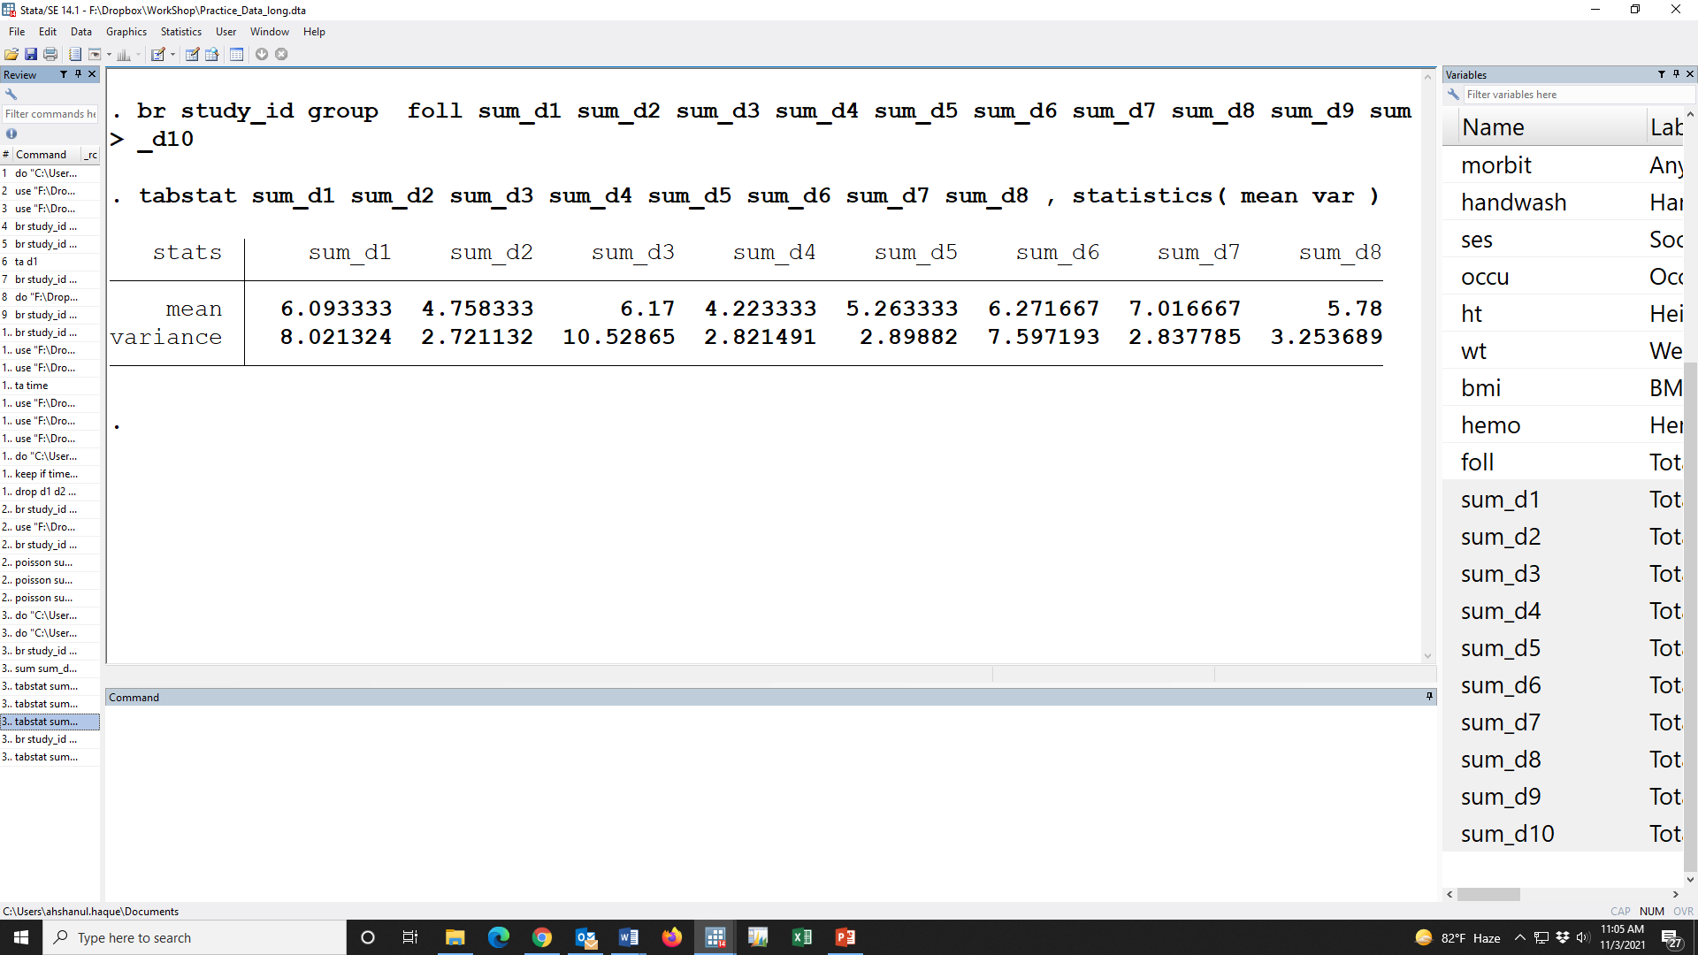

Slide 54
How to model the data

Slide 55
How to model the data
Poisson or Negative binomial

Slide 56
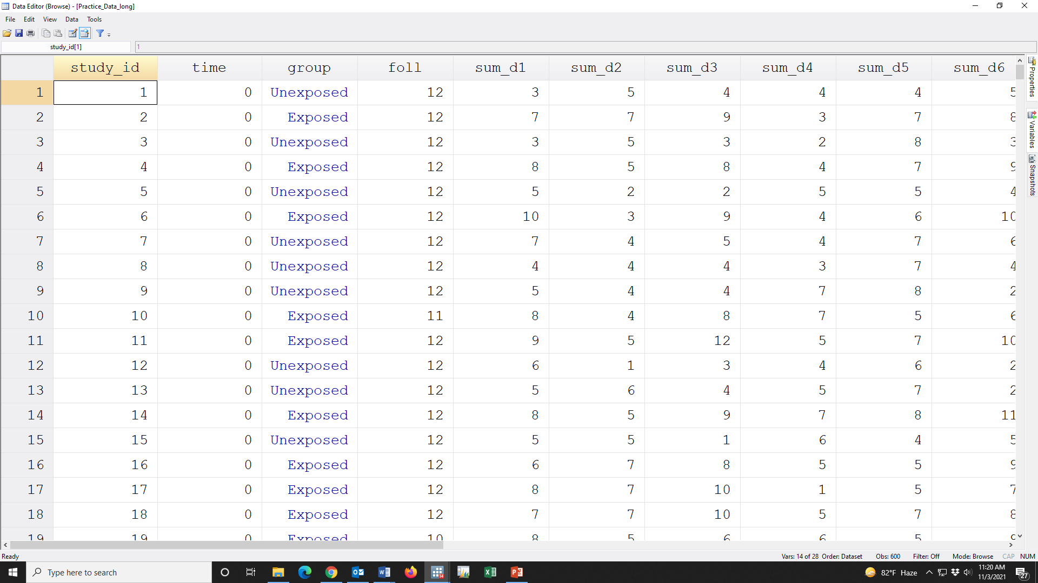

Slide 58
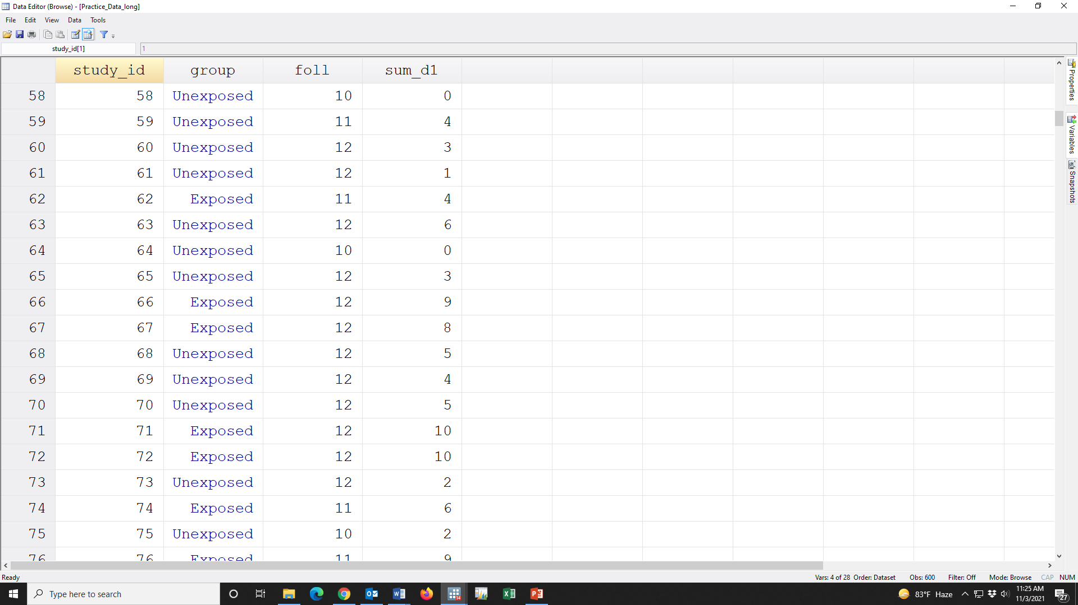

Slide 59
Y
X

Slide 60
Y
X
log(Y)=a +bX

Slide 61
Y
X
log(Y)=a +bX

Slide 62
Y
X
log(Y)=a +bX

Slide 63
Y
X
log(Y)=a +bX

Slide 64
Y
X
log(Y)=a +bX

Slide 65
t
Y
X
log(Y)=a +bX

Slide 66
t
Y
X
log(Y/t)=a +bX

Slide 67
t
Y
X
log(Y/t)=a +bX
log(Y)-log(t)=a +bX

Slide 68
t
Y
X
log(Y/t)=a +bX
log(Y)-log(t)=a +bX
log(Y)= a +bX+log(t)

Slide 69
log(Y/t)=a +bX
log(Y)-log(t)=a +bX
log(Y)= a +bX+log(t)
Dependent variable
Independent variable

Slide 70
log(Y/t)=a +bX
log(Y)-log(t)=a +bX
log(Y)= a +bX+log(t)
Dependent variable
Independent variable
Offset variable

Slide 71
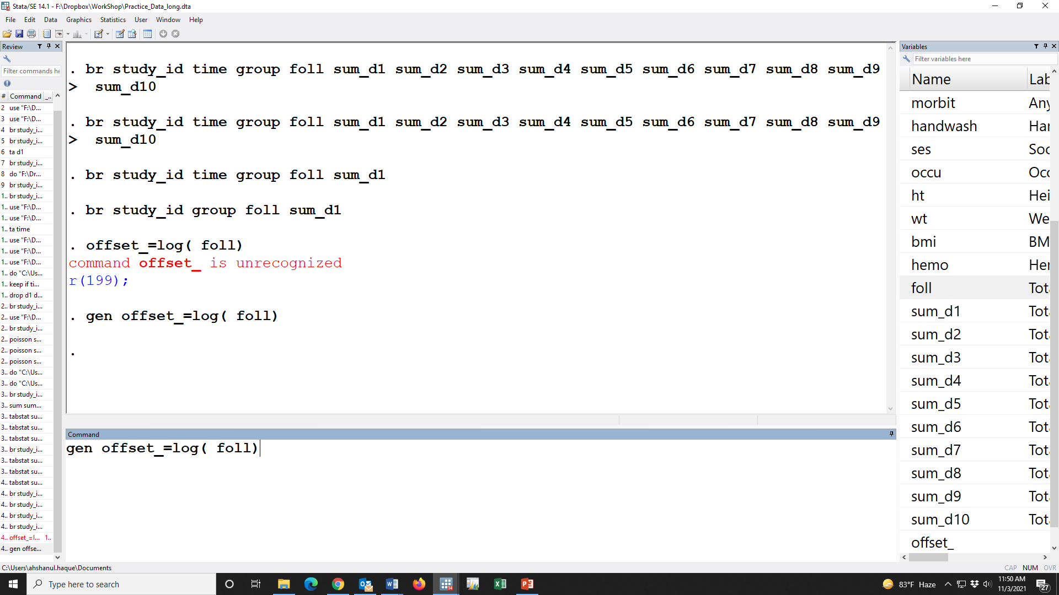

Slide 72
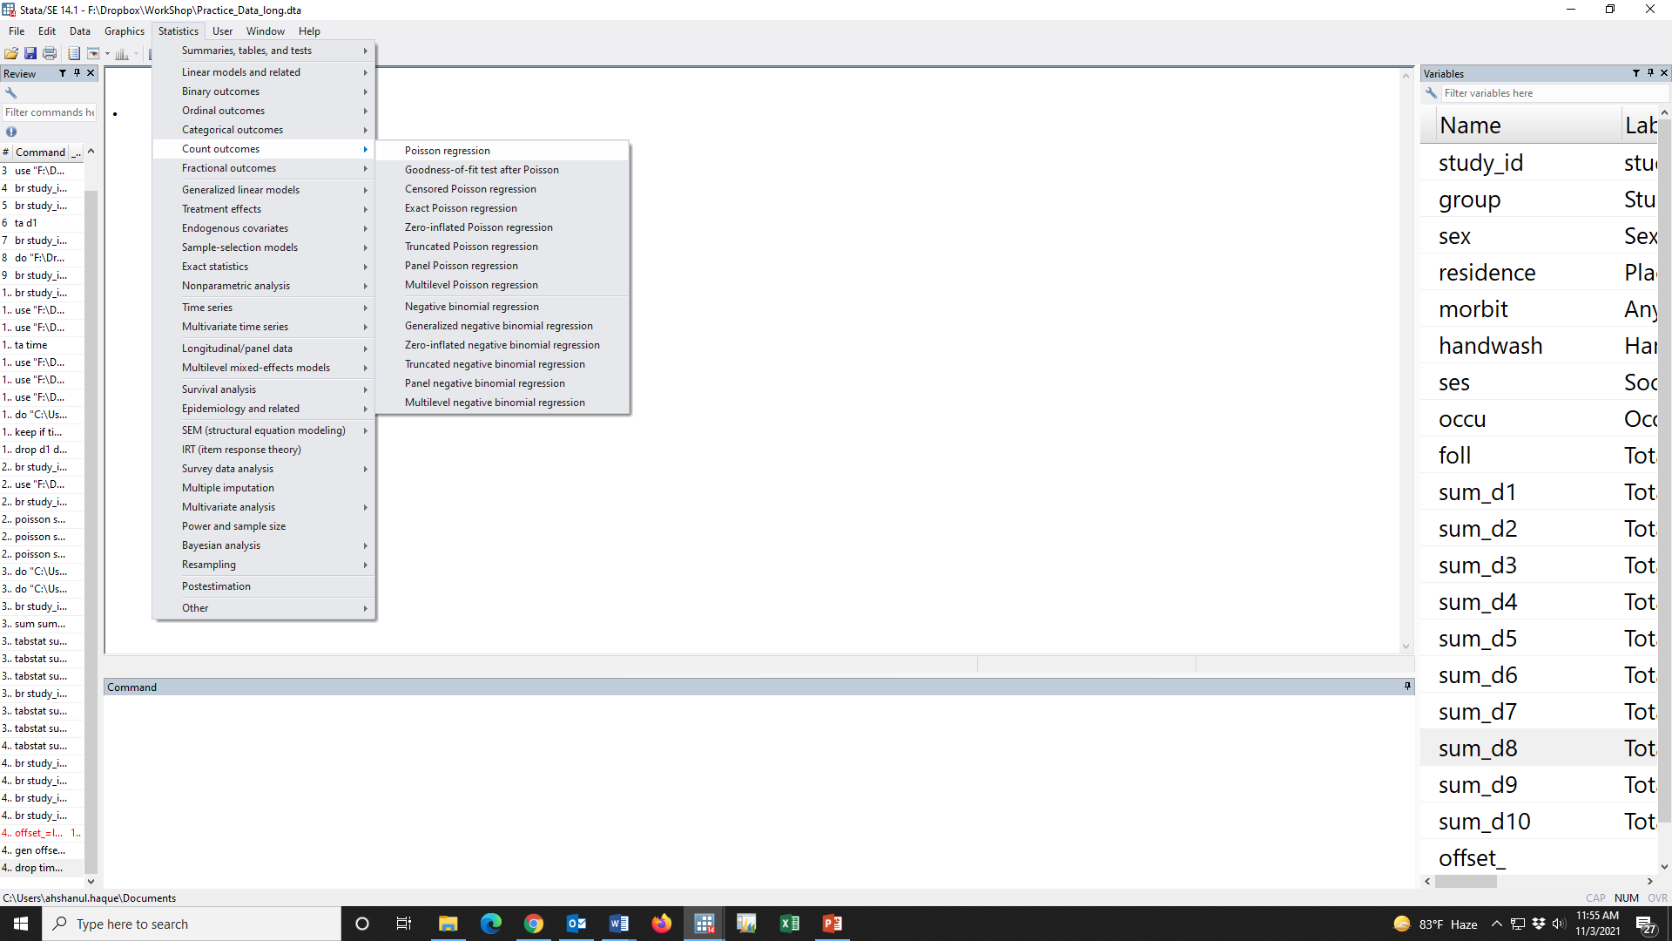

Slide 74
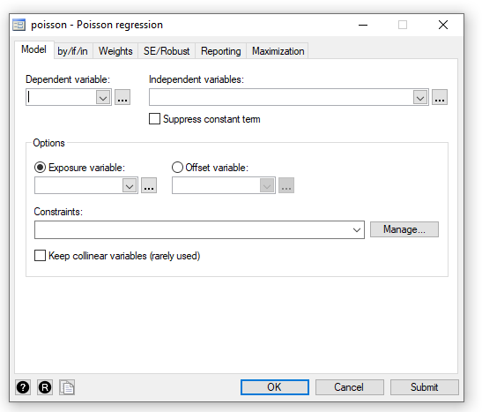

Slide 77
sum_d1
i.group
offset_

Slide 78
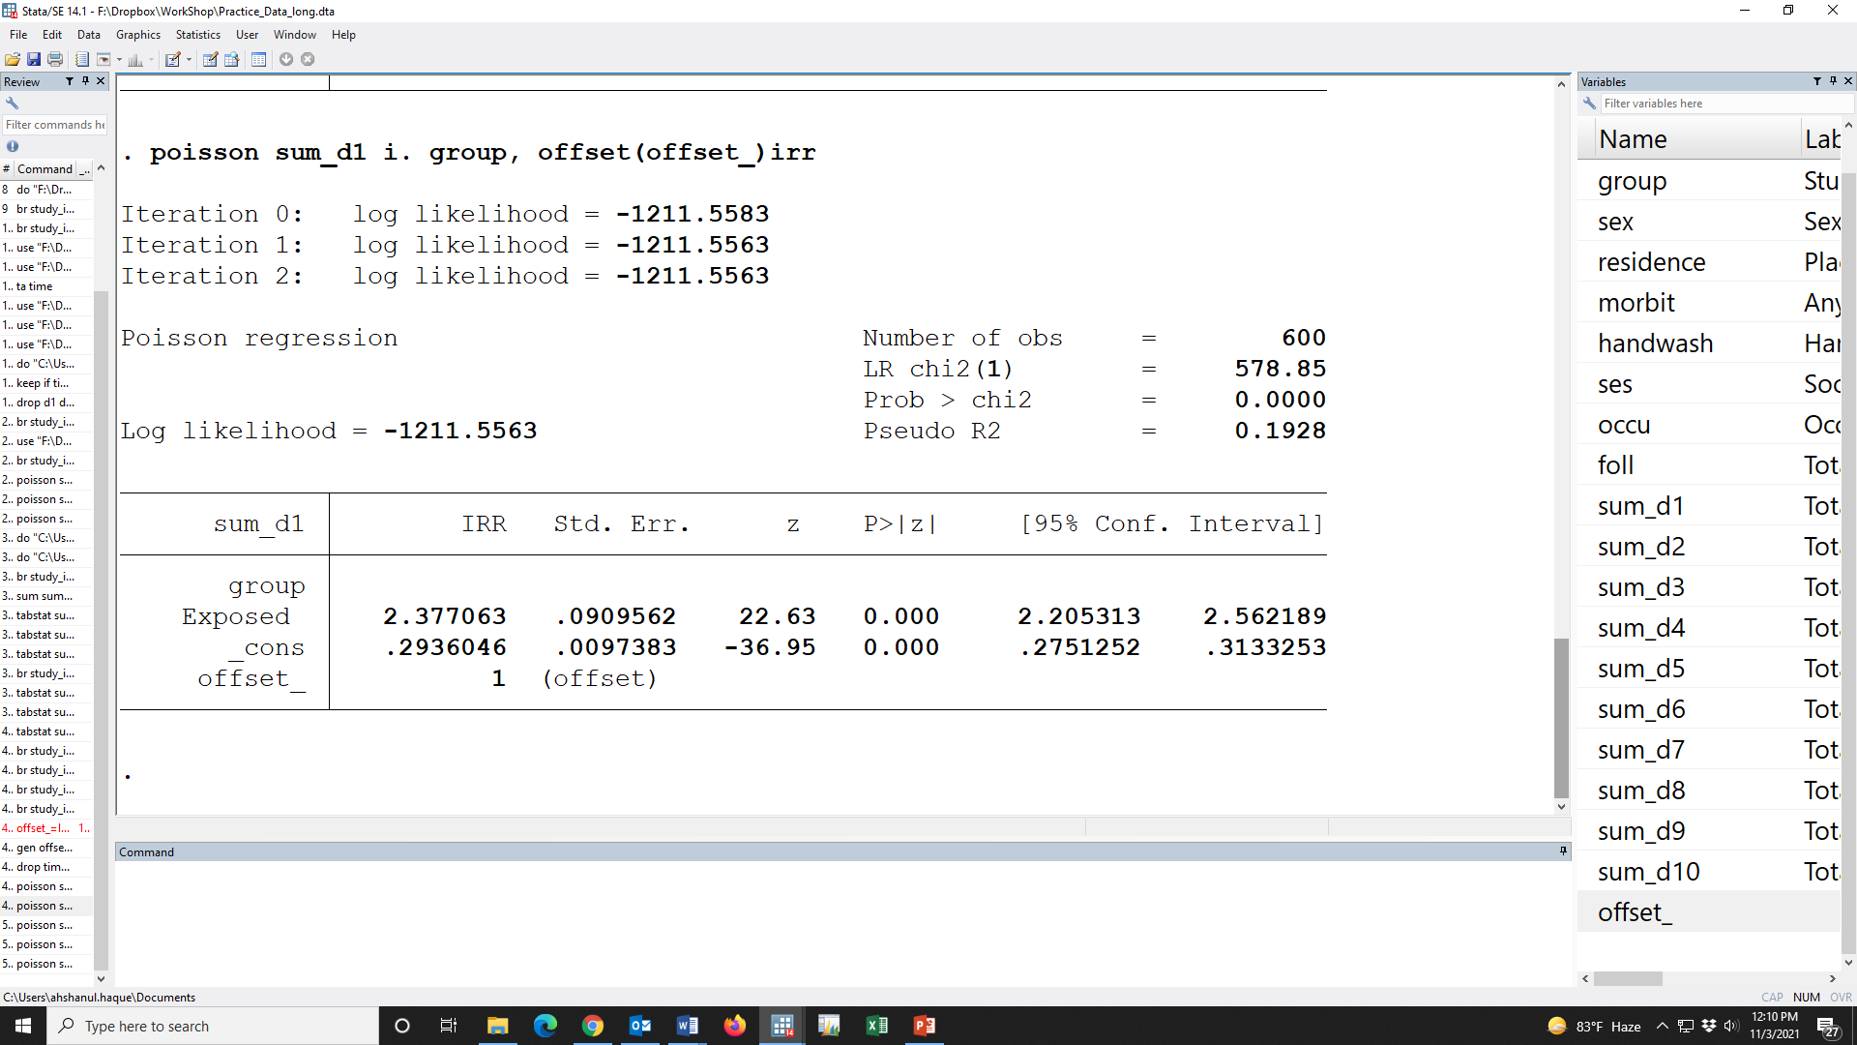

Slide 80
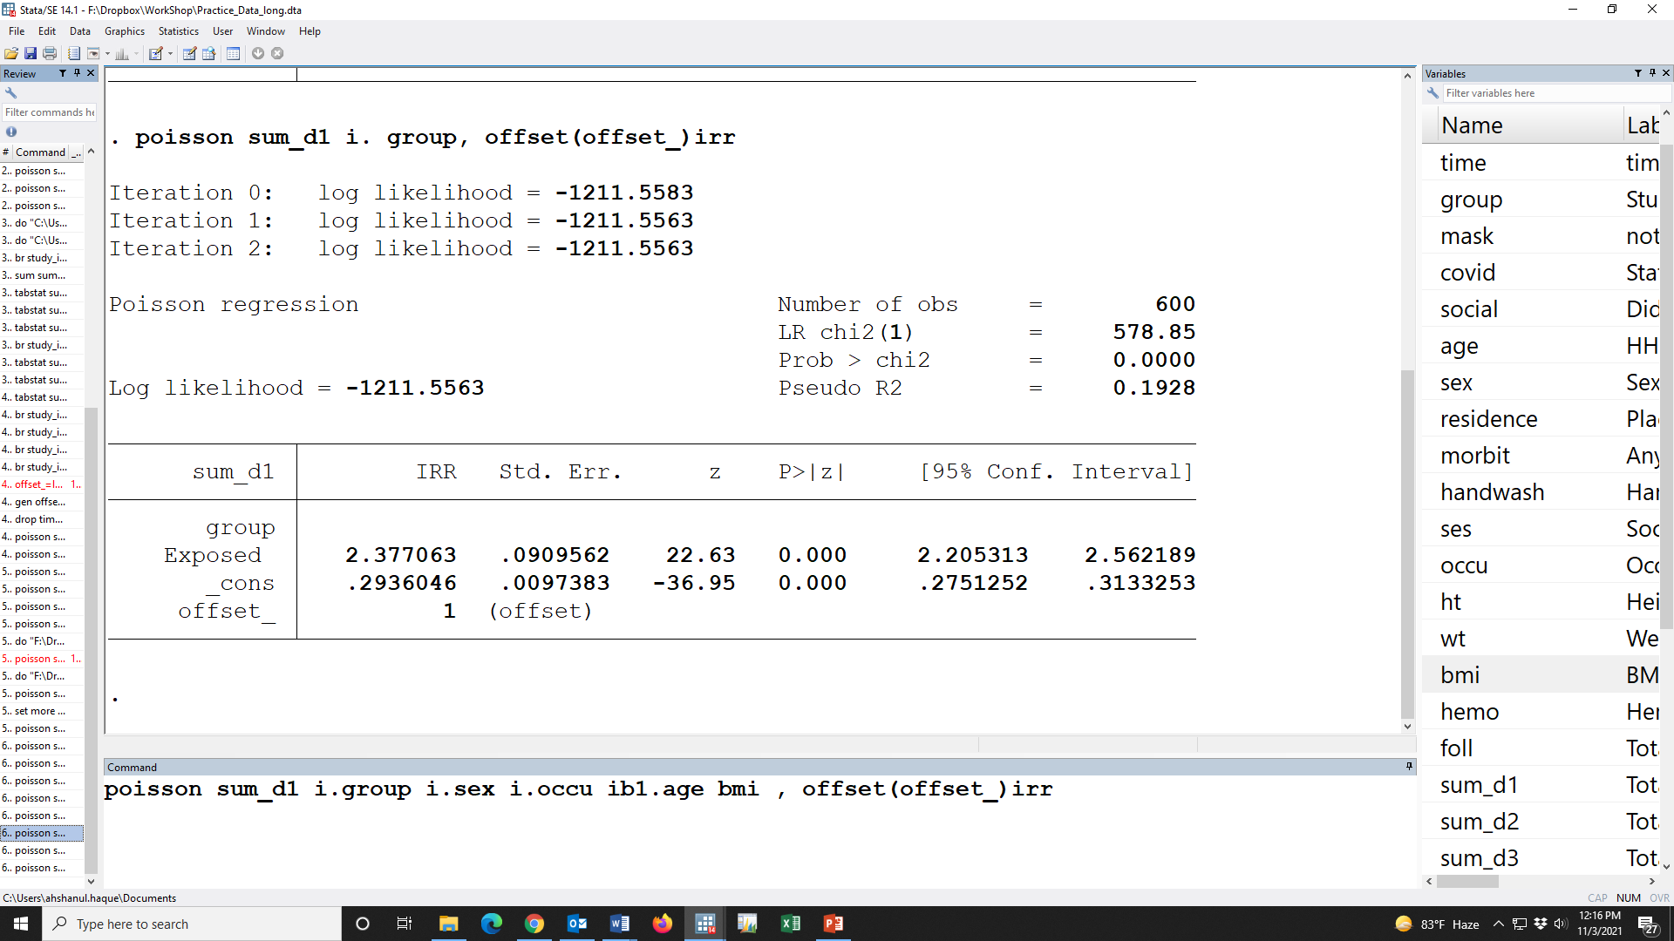

Slide 81
 |  |  | Unadjusted IRR (95% CI) | p-value | Adjusted IRR (95% CI) | p-value
Study group
 | unexposed |  | Reference |  | Reference
 | Exposed |  | 2.38 (2.21, 2.56) | 0.000 | 2.34 (2.06, 2.65) | 0.000
Sex of participant
 | Female |  | Reference |  | Reference
 | Male |  | 1.00 (0.93, 1.07) | 0.943 | 1.01 (0.94, 1.09) | 0.786
Occupation
 | None |  | Reference |  | Reference
 | Service |  | 1.07 (0.97, 1.17) | 0.182 | 1.03 (0.94, 1.13) | 0.542
 | Business |  | 1.02 (0.94, 1.11) | 0.602 | 1 (0.93, 1.09) | 0.906
Age in year
 | <30Y |  | Reference |  | Reference
 | >=30Y |  | 1.01 (0.95, 1.08) | 0.693 | 1.01 (0.94, 1.08) | 0.823
BMI |  |  | 1.03 (1.02, 1.04) | 0.000 | 1 (1, 1.01) | 0.557
SES
 |  | Rich | Reference |  | Reference
 |  | Middle | 0.96 (0.89, 1.04) | 0.335 | 0.99 (0.92, 1.07) | 0.846
 |  | Poor | 0.97 (0.89, 1.06) | 0.498 | 1 (0.92, 1.1) | 0.938
Hemoglobin status |  |  | 0.83 (0.81, 0.84) | 0.000 | 1 (0.96, 1.03) | 0.883

Slide 82
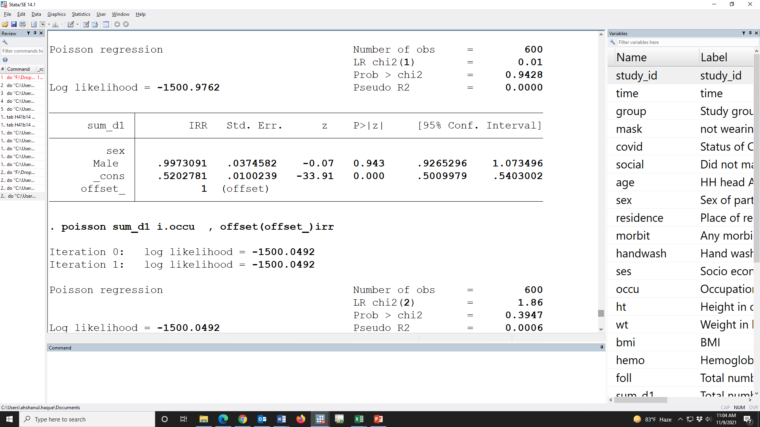

Slide 83
 |  |  | Unadjusted IRR (95% CI) | p-value | Adjusted IRR (95% CI) | p-value
Study group
 | unexposed |  | Reference |  | Reference
 | Exposed |  | 2.38 (2.21, 2.56) | 0.000 | 2.34 (2.06, 2.65) | 0.000
Sex of participant
 | Female |  | Reference |  | Reference
 | Male |  | 1.00 (0.93, 1.07) | 0.943 | 1.01 (0.94, 1.09) | 0.786
Occupation
 | None |  | Reference |  | Reference
 | Service |  | 1.07 (0.97, 1.17) | 0.182 | 1.03 (0.94, 1.13) | 0.542
 | Business |  | 1.02 (0.94, 1.11) | 0.602 | 1 (0.93, 1.09) | 0.906
Age in year
 | <30Y |  | Reference |  | Reference
 | >=30Y |  | 1.01 (0.95, 1.08) | 0.693 | 1.01 (0.94, 1.08) | 0.823
BMI |  |  | 1.03 (1.02, 1.04) | 0.000 | 1 (1, 1.01) | 0.557
SES
 |  | Rich | Reference |  | Reference
 |  | Middle | 0.96 (0.89, 1.04) | 0.335 | 0.99 (0.92, 1.07) | 0.846
 |  | Poor | 0.97 (0.89, 1.06) | 0.498 | 1 (0.92, 1.1) | 0.938
Hemoglobin status |  |  | 0.83 (0.81, 0.84) | 0.000 | 1 (0.96, 1.03) | 0.883

Slide 84
 |  |  | Unadjusted IRR (95% CI) | p-value | Adjusted IRR (95% CI) | p-value
Study group
 | unexposed |  | Reference |  | Reference
 | Exposed |  | 2.38 (2.21, 2.56) | 0.000 | 2.34 (2.06, 2.65) | 0.000
Sex of participant
 | Female |  | Reference |  | Reference
 | Male |  | 1.00 (0.93, 1.07) | 0.943 | 1.01 (0.94, 1.09) | 0.786
Occupation
 | None |  | Reference |  | Reference
 | Service |  | 1.07 (0.97, 1.17) | 0.182 | 1.03 (0.94, 1.13) | 0.542
 | Business |  | 1.02 (0.94, 1.11) | 0.602 | 1 (0.93, 1.09) | 0.906
Age in year
 | <30Y |  | Reference |  | Reference
 | >=30Y |  | 1.01 (0.95, 1.08) | 0.693 | 1.01 (0.94, 1.08) | 0.823
BMI |  |  | 1.03 (1.02, 1.04) | 0.000 | 1 (1, 1.01) | 0.557
SES
 |  | Rich | Reference |  | Reference
 |  | Middle | 0.96 (0.89, 1.04) | 0.335 | 0.99 (0.92, 1.07) | 0.846
 |  | Poor | 0.97 (0.89, 1.06) | 0.498 | 1 (0.92, 1.1) | 0.938
Hemoglobin status |  |  | 0.83 (0.81, 0.84) | 0.000 | 1 (0.96, 1.03) | 0.883

Slide 85
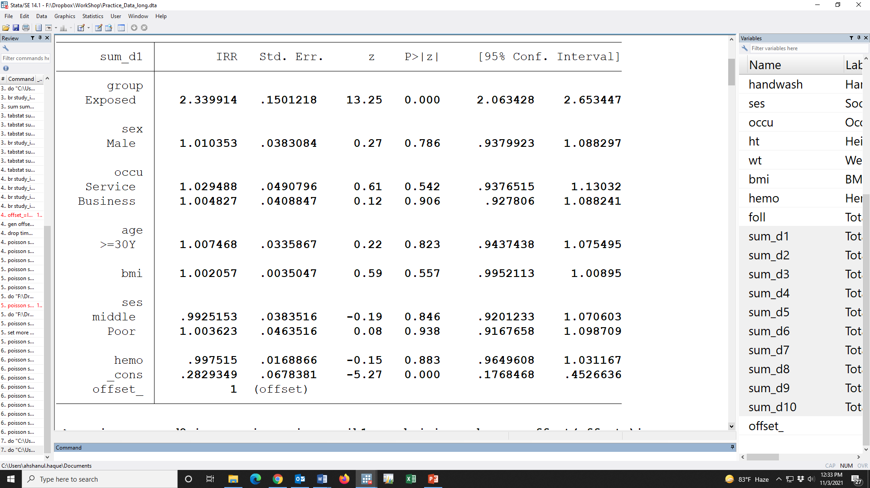

Slide 86
 |  |  | Unadjusted IRR (95% CI) | p-value | Adjusted IRR (95% CI) | p-value
Study group
 | unexposed |  | Reference |  | Reference
 | Exposed |  | 2.38 (2.21, 2.56) | 0.000 | 2.34 (2.06, 2.65) | 0.000
Sex of participant
 | Female |  | Reference |  | Reference
 | Male |  | 1.00 (0.93, 1.07) | 0.943 | 1.01 (0.94, 1.09) | 0.786
Occupation
 | None |  | Reference |  | Reference
 | Service |  | 1.07 (0.97, 1.17) | 0.182 | 1.03 (0.94, 1.13) | 0.542
 | Business |  | 1.02 (0.94, 1.11) | 0.602 | 1 (0.93, 1.09) | 0.906
Age in year
 | <30Y |  | Reference |  | Reference
 | >=30Y |  | 1.01 (0.95, 1.08) | 0.693 | 1.01 (0.94, 1.08) | 0.823
BMI |  |  | 1.03 (1.02, 1.04) | 0.000 | 1.00 (1.00, 1.01) | 0.557
SES
 |  | Rich | Reference |  | Reference
 |  | Middle | 0.96 (0.89, 1.04) | 0.335 | 0.99 (0.92, 1.07) | 0.846
 |  | Poor | 0.97 (0.89, 1.06) | 0.498 | 1.00 (0.92, 1.10) | 0.938
Hemoglobin status |  |  | 0.83 (0.81, 0.84) | 0.000 | 1.00 (0.96, 1.03) | 0.883

Slide 87
 |  |  | Unadjusted IRR (95% CI) | p-value | Adjusted IRR (95% CI) | p-value
Study group
 | unexposed |  | Reference |  | Reference
 | Exposed |  | 2.38 (2.21, 2.56) | 0.000 | 2.34 (2.06, 2.65) | 0.000
Sex of participant
 | Female |  | Reference |  | Reference
 | Male |  | 1.00 (0.93, 1.07) | 0.943 | 1.01 (0.94, 1.09) | 0.786
Occupation
 | None |  | Reference |  | Reference
 | Service |  | 1.07 (0.97, 1.17) | 0.182 | 1.03 (0.94, 1.13) | 0.542
 | Business |  | 1.02 (0.94, 1.11) | 0.602 | 1 (0.93, 1.09) | 0.906
Age in year
 | <30Y |  | Reference |  | Reference
 | >=30Y |  | 1.01 (0.95, 1.08) | 0.693 | 1.01 (0.94, 1.08) | 0.823
BMI |  |  | 1.03 (1.02, 1.04) | 0.000 | 1.00 (1.00, 1.01) | 0.557
SES
 |  | Rich | Reference |  | Reference
 |  | Middle | 0.96 (0.89, 1.04) | 0.335 | 0.99 (0.92, 1.07) | 0.846
 |  | Poor | 0.97 (0.89, 1.06) | 0.498 | 1.00 (0.92, 1.10) | 0.938
Hemoglobin status |  |  | 0.83 (0.81, 0.84) | 0.000 | 1.00 (0.96, 1.03) | 0.883
The unadjusted and adjusted incidence rate ratios were given in the Table ##. After adjusting the relevant covariates, the incidence rate of C.jejuni/coli infection was 2.34 [IRR: 2.34 (95% CI: 2.06, 2.65); p-value<0.001] time in the exposed group compare to the unexposed group which indicates that the exposure was significantly associated with C.jejuni/coli.

Slide 88
The objective of this study to identify the incidence rate of Campylobacter jejuni/coli, Clostridium difficile, EAEC, aEPEC, tEPEC, LT-ETEC, ST-ETEC, Shigella/EIEC, Astrovirus and Sapovirus infection in the exposed group compare to the unexposed group.

Slide 89
Campylobacter jejuni/coli
Clostridium difficile
EAEC
aEPEC
tEPEC
LT-ETEC
ST-ETEC
Shigella/EIEC
Astrovirus
Sapovirus
age, sex, occupation, BMI, SES, Hemoglobin status
Exposure

Slide 90
The objective of this study to identify the incidence rate of Campylobacter jejuni/coli, Clostridium difficile, EAEC, aEPEC, tEPEC, LT-ETEC, ST-ETEC, Shigella/EIEC, Astrovirus and Sapovirus infection in the exposed group compare to the unexposed group.

Slide 92
Table ##. Association between exposure and pathogen infection
Pathogen | Unadjusted IRR (95% CI) | p-value | Adjusted IRR (95% CI) | p-value
Campylobacter jejuni/coli | 2.38 (2.21, 2.56) | 0.000 | 2.34 (2.06, 2.65) | 0.000
Clostridium difficile | 1.01 (0.94, 1.09) | 0.764 | 1.09 (0.95, 1.25) | 0.222
EAEC | 2.95 (2.73, 3.19) | 0.000 | 2.85 (2.51, 3.24) | 0.000
aEPEC | 0.97 (0.90, 1.05) | 0.513 | 0.98 (0.85, 1.13) | 0.761
tEPEC | 1.02 (0.95, 1.09) | 0.631 | 0.94 (0.83, 1.07) | 0.366
LT-ETEC | 2.23 (2.07, 2.40) | 0.000 | 2.21 (1.95, 2.50) | 0.000
ST-ETEC | 1.00 (0.94, 1.06) | 0.915 | 0.97 (0.87, 1.08) | 0.565
Shigella/EIEC | 0.97 (0.91, 1.04) | 0.429 | 0.99 (0.87, 1.12) | 0.866
Astrovirus | 2.41 (2.23, 2.60) | 0.000 | 2.39 (2.11, 2.72) | 0.000
Sapovirus | 2.34 (2.17, 2.53) | 0.000 | 2.36 (2.08, 2.68) | 0.000
Adjusted in the Poisson model for age, sex, occupation, BMI, SES, Hemoglobin status; log of total number of follow up as offset variable

Slide 93
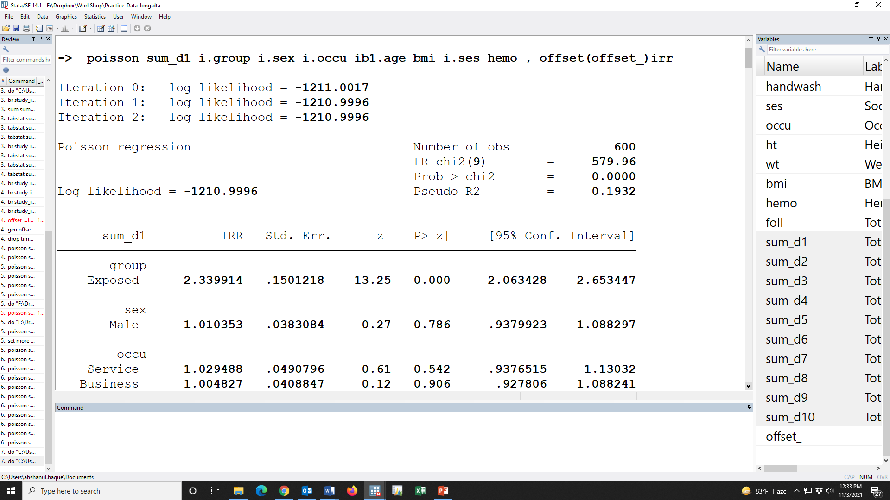

Slide 95
 |  | Unadjusted IRR (95% CI) | p-value | Adjusted IRR (95% CI) | p-value
Study group
 | unexposed | Reference |  | Reference
 | Exposed | 2.38 (2.21, 2.56) | 0.000 | 2.34 (2.06, 2.65) | 0.000
Sex of participant
 | Female | Reference |  | Reference
 | Male | 1.00 (0.93, 1.07) | 0.943 | 1.01 (0.94, 1.09) | 0.786
Occupation
 | None | Reference |  | Reference
 | Service | 1.07 (0.97, 1.17) | 0.182 | 1.03 (0.94, 1.13) | 0.542
 | Business | 1.02 (0.94, 1.11) | 0.602 | 1 (0.93, 1.09) | 0.906
Age in year
 | <30Y | Reference |  | Reference
 | >=30Y | 1.01 (0.95, 1.08) | 0.693 | 1.01 (0.94, 1.08) | 0.823
BMI |  | 1.03 (1.02, 1.04) | 0.000 | 1 (1, 1.01) | 0.557
SES
 | Rich | Reference |  | Reference
 | Middle | 0.96 (0.89, 1.04) | 0.335 | 0.99 (0.92, 1.07) | 0.846
 | Poor | 0.97 (0.89, 1.06) | 0.498 | 1 (0.92, 1.1) | 0.938
Hemoglobin status |  | 0.83 (0.81, 0.84) | 0.000 | 1 (0.96, 1.03) | 0.883

Slide 96
Table ##. Association between exposure and pathogen infection
Pathogen | Unadjusted IRR (95% CI) | p-value | Adjusted IRR (95% CI) | p-value
Campylobacter jejuni/coli | 2.38 (2.21, 2.56) | 0.000 | 2.34 (2.06, 2.65) | 0.000
Clostridium difficile | 1.01 (0.94, 1.09) | 0.764 | 1.09 (0.95, 1.25) | 0.222
EAEC | 2.95 (2.73, 3.19) | 0.000 | 2.85 (2.51, 3.24) | 0.000
aEPEC | 0.97 (0.90, 1.05) | 0.513 | 0.98 (0.85, 1.13) | 0.761
tEPEC | 1.02 (0.95, 1.09) | 0.631 | 0.94 (0.83, 1.07) | 0.366
LT-ETEC | 2.23 (2.07, 2.40) | 0.000 | 2.21 (1.95, 2.50) | 0.000
ST-ETEC | 1.00 (0.94, 1.06) | 0.915 | 0.97 (0.87, 1.08) | 0.565
Shigella/EIEC | 0.97 (0.91, 1.04) | 0.429 | 0.99 (0.87, 1.12) | 0.866
Astrovirus | 2.41 (2.23, 2.60) | 0.000 | 2.39 (2.11, 2.72) | 0.000
Sapovirus | 2.34 (2.17, 2.53) | 0.000 | 2.36 (2.08, 2.68) | 0.000
Adjusted in the Poisson model for age, sex, occupation, BMI, SES, Hemoglobin status; log of total number of follow up as offset variable

Slide 97
Table ##. Association between exposure and pathogen infection
Pathogen | Unadjusted IRR (95% CI) | p-value | Adjusted IRR (95% CI) | p-value
Campylobacter jejuni/coli | 2.38 (2.21, 2.56) | 0.000 | 2.34 (2.06, 2.65) | 0.000
Clostridium difficile | 1.01 (0.94, 1.09) | 0.764 | 1.09 (0.95, 1.25) | 0.222
EAEC | 2.95 (2.73, 3.19) | 0.000 | 2.85 (2.51, 3.24) | 0.000
aEPEC | 0.97 (0.90, 1.05) | 0.513 | 0.98 (0.85, 1.13) | 0.761
tEPEC | 1.02 (0.95, 1.09) | 0.631 | 0.94 (0.83, 1.07) | 0.366
LT-ETEC | 2.23 (2.07, 2.40) | 0.000 | 2.21 (1.95, 2.50) | 0.000
ST-ETEC | 1.00 (0.94, 1.06) | 0.915 | 0.97 (0.87, 1.08) | 0.565
Shigella/EIEC | 0.97 (0.91, 1.04) | 0.429 | 0.99 (0.87, 1.12) | 0.866
Astrovirus | 2.41 (2.23, 2.60) | 0.000 | 2.39 (2.11, 2.72) | 0.000
Sapovirus | 2.34 (2.17, 2.53) | 0.000 | 2.36 (2.08, 2.68) | 0.000
Adjusted in the Poisson model for age, sex, occupation, BMI, SES, Hemoglobin status; log of total number of follow up as offset variable

Slide 98
Table ##. Association between exposure and pathogen infection
Pathogen | Unadjusted IRR (95% CI) | p-value | Adjusted IRR (95% CI) | p-value
Campylobacter jejuni/coli | 2.38 (2.21, 2.56) | 0.000 | 2.34 (2.06, 2.65) | 0.000
Clostridium difficile | 1.01 (0.94, 1.09) | 0.764 | 1.09 (0.95, 1.25) | 0.222
EAEC | 2.95 (2.73, 3.19) | 0.000 | 2.85 (2.51, 3.24) | 0.000
aEPEC | 0.97 (0.90, 1.05) | 0.513 | 0.98 (0.85, 1.13) | 0.761
tEPEC | 1.02 (0.95, 1.09) | 0.631 | 0.94 (0.83, 1.07) | 0.366
LT-ETEC | 2.23 (2.07, 2.40) | 0.000 | 2.21 (1.95, 2.50) | 0.000
ST-ETEC | 1.00 (0.94, 1.06) | 0.915 | 0.97 (0.87, 1.08) | 0.565
Shigella/EIEC | 0.97 (0.91, 1.04) | 0.429 | 0.99 (0.87, 1.12) | 0.866
Astrovirus | 2.41 (2.23, 2.60) | 0.000 | 2.39 (2.11, 2.72) | 0.000
Sapovirus | 2.34 (2.17, 2.53) | 0.000 | 2.36 (2.08, 2.68) | 0.000
Adjusted in the Poisson model for age, sex, occupation, BMI, SES, Hemoglobin status; log of total number of follow up as offset variable

Slide 99
Table ##. Association between exposure and pathogen infection
Pathogen | Unadjusted IRR (95% CI) | p-value | Adjusted IRR (95% CI) | p-value
Campylobacter jejuni/coli | 2.38 (2.21, 2.56) | 0.000 | 2.34 (2.06, 2.65) | 0.000
Clostridium difficile | 1.01 (0.94, 1.09) | 0.764 | 1.09 (0.95, 1.25) | 0.222
EAEC | 2.95 (2.73, 3.19) | 0.000 | 2.85 (2.51, 3.24) | 0.000
aEPEC | 0.97 (0.90, 1.05) | 0.513 | 0.98 (0.85, 1.13) | 0.761
tEPEC | 1.02 (0.95, 1.09) | 0.631 | 0.94 (0.83, 1.07) | 0.366
LT-ETEC | 2.23 (2.07, 2.40) | 0.000 | 2.21 (1.95, 2.50) | 0.000
ST-ETEC | 1.00 (0.94, 1.06) | 0.915 | 0.97 (0.87, 1.08) | 0.565
Shigella/EIEC | 0.97 (0.91, 1.04) | 0.429 | 0.99 (0.87, 1.12) | 0.866
Astrovirus | 2.41 (2.23, 2.60) | 0.000 | 2.39 (2.11, 2.72) | 0.000
Sapovirus | 2.34 (2.17, 2.53) | 0.000 | 2.36 (2.08, 2.68) | 0.000
Adjusted in the Poisson model for age, sex, occupation, BMI, SES, Hemoglobin status; log of total number of follow up as offset variable

Slide 100
Table ##. Association between exposure and pathogen infection
Pathogen | Unadjusted IRR (95% CI) | p-value | Adjusted IRR (95% CI) | p-value
Campylobacter jejuni/coli | 2.38 (2.21, 2.56) | 0.000 | 2.34 (2.06, 2.65) | 0.000
Clostridium difficile | 1.01 (0.94, 1.09) | 0.764 | 1.09 (0.95, 1.25) | 0.222
EAEC | 2.95 (2.73, 3.19) | 0.000 | 2.85 (2.51, 3.24) | 0.000
aEPEC | 0.97 (0.90, 1.05) | 0.513 | 0.98 (0.85, 1.13) | 0.761
tEPEC | 1.02 (0.95, 1.09) | 0.631 | 0.94 (0.83, 1.07) | 0.366
LT-ETEC | 2.23 (2.07, 2.40) | 0.000 | 2.21 (1.95, 2.50) | 0.000
ST-ETEC | 1.00 (0.94, 1.06) | 0.915 | 0.97 (0.87, 1.08) | 0.565
Shigella/EIEC | 0.97 (0.91, 1.04) | 0.429 | 0.99 (0.87, 1.12) | 0.866
Astrovirus | 2.41 (2.23, 2.60) | 0.000 | 2.39 (2.11, 2.72) | 0.000
Sapovirus | 2.34 (2.17, 2.53) | 0.000 | 2.36 (2.08, 2.68) | 0.000
Adjusted in the Poisson model for age, sex, occupation, BMI, SES, Hemoglobin status; log of total number of follow up as offset variable

Slide 101
Over dispersion parameter
Notes:
The likelihood ratio test at the bottom of the analysis is a test of the overdispersion parameter alpha. When the overdispersion parameter is zero the negative binomial distribution is equivalent to a Poisson distribution. In this case, alpha is significantly different from zero and thus reinforces one last time that the Poisson distribution is not appropriate.

Slide 103
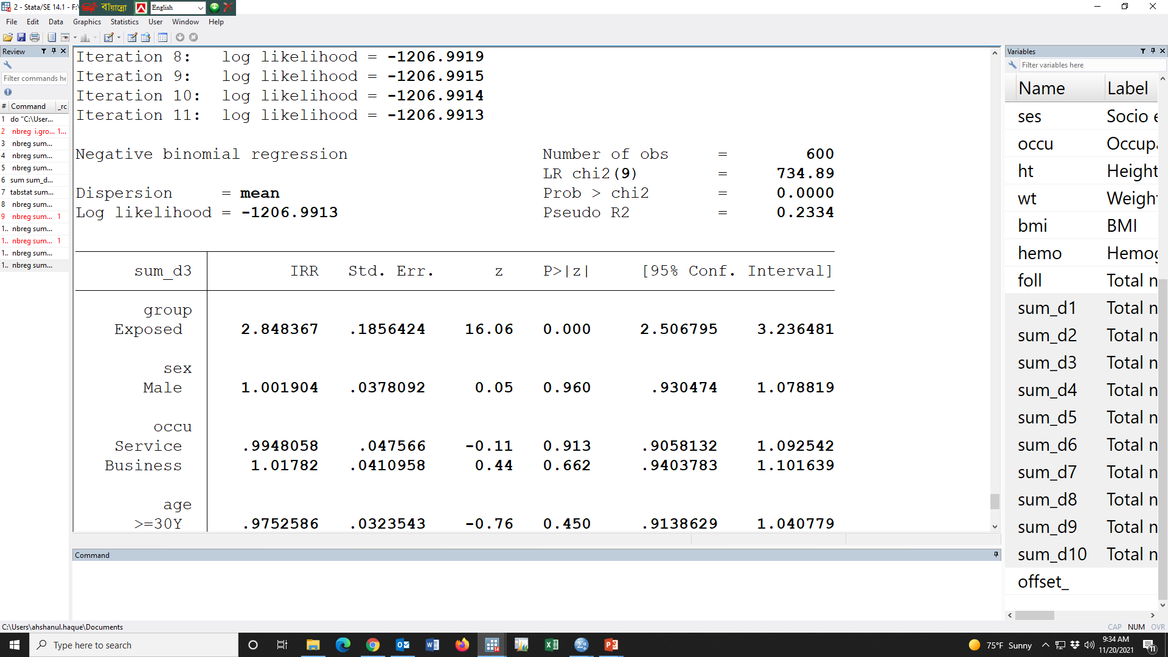
nbreg sum_d3 i.group i.sex i.occu ib1.age bmi i.ses hemo , offset(offset_)irr

Slide 104
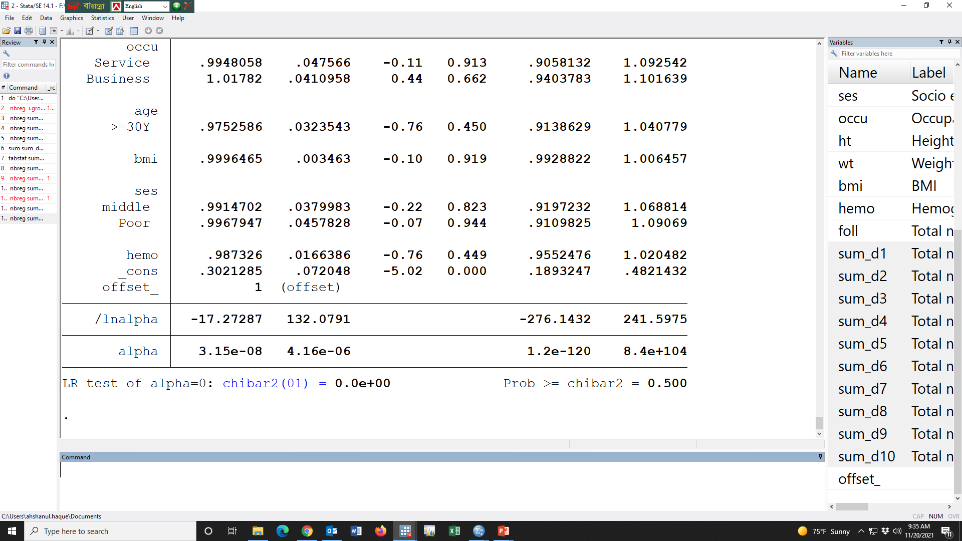

Slide 105
যদি Significant (p<0.05)হতো, তাহলে অবশ্যই nbreg ব্যবহার করতাম

Slide 106
0.003
Let us suppose that the dispersion parameter is significant ….

Slide 107
Table ##. Association between exposure and pathogen infection
Pathogen | Unadjusted IRR (95% CI) | p-value | Adjusted IRR (95% CI) | p-value
Campylobacter jejuni/coli | 2.38 (2.21, 2.56) | 0.000 | 2.34 (2.06, 2.65) | 0.000
Clostridium difficile | 1.01 (0.94, 1.09) | 0.764 | 1.09 (0.95, 1.25) | 0.222
EAEC | 2.95 (2.73, 3.19) | 0.000 | 2.85 (2.51, 3.24) | 0.000
aEPEC | 0.97 (0.90, 1.05) | 0.513 | 0.98 (0.85, 1.13) | 0.761
tEPEC | 1.02 (0.95, 1.09) | 0.631 | 0.94 (0.83, 1.07) | 0.366
LT-ETEC | 2.23 (2.07, 2.40) | 0.000 | 2.21 (1.95, 2.50) | 0.000
ST-ETEC | 1.00 (0.94, 1.06) | 0.915 | 0.97 (0.87, 1.08) | 0.565
Shigella/EIEC | 0.97 (0.91, 1.04) | 0.429 | 0.99 (0.87, 1.12) | 0.866
Astrovirus | 2.41 (2.23, 2.60) | 0.000 | 2.39 (2.11, 2.72) | 0.000
Sapovirus | 2.34 (2.17, 2.53) | 0.000 | 2.36 (2.08, 2.68) | 0.000
Adjusted in the Poisson model for age, sex, occupation, BMI, SES, Hemoglobin status; log of total number of follow up as offset variable

Slide 108
Table ##. Association between exposure and pathogen infection
Pathogen | Unadjusted IRR (95% CI) | p-value | Adjusted IRR (95% CI) | p-value
Campylobacter jejuni/coli | 2.38 (2.21, 2.56) | 0.000 | 2.34 (2.06, 2.65) | 0.000
Clostridium difficile | 1.01 (0.94, 1.09) | 0.764 | 1.09 (0.95, 1.25) | 0.222
EAEC! | 2.95 (2.73, 3.19) | 0.000 | 2.84 (2.51, 3.24) | 0.000
aEPEC | 0.97 (0.90, 1.05) | 0.513 | 0.98 (0.85, 1.13) | 0.761
tEPEC | 1.02 (0.95, 1.09) | 0.631 | 0.94 (0.83, 1.07) | 0.366
LT-ETEC | 2.23 (2.07, 2.40) | 0.000 | 2.21 (1.95, 2.50) | 0.000
ST-ETEC | 1.00 (0.94, 1.06) | 0.915 | 0.97 (0.87, 1.08) | 0.565
Shigella/EIEC | 0.97 (0.91, 1.04) | 0.429 | 0.99 (0.87, 1.12) | 0.866
Astrovirus | 2.41 (2.23, 2.60) | 0.000 | 2.39 (2.11, 2.72) | 0.000
Sapovirus | 2.34 (2.17, 2.53) | 0.000 | 2.36 (2.08, 2.68) | 0.000
Adjusted in the Poisson model for age, sex, occupation, BMI, SES, Hemoglobin status; log of total number of follow up as offset variable
!Negative binomial regression was used due to over dispersion parameter

Slide 109
Table ##. Association between exposure and pathogen infection
Pathogen | Unadjusted IRR (95% CI) | p-value | Adjusted IRR (95% CI) | p-value
Campylobacter jejuni/coli | 2.38 (2.21, 2.56) | 0.000 | 2.34 (2.06, 2.65) | 0.000
Clostridium difficile | 1.01 (0.94, 1.09) | 0.764 | 1.09 (0.95, 1.25) | 0.222
EAEC! | 2.95 (2.73, 3.19) | 0.000 | 2.84 (2.51, 3.24) | 0.000
aEPEC | 0.97 (0.90, 1.05) | 0.513 | 0.98 (0.85, 1.13) | 0.761
tEPEC | 1.02 (0.95, 1.09) | 0.631 | 0.94 (0.83, 1.07) | 0.366
LT-ETEC | 2.23 (2.07, 2.40) | 0.000 | 2.21 (1.95, 2.50) | 0.000
ST-ETEC | 1.00 (0.94, 1.06) | 0.915 | 0.97 (0.87, 1.08) | 0.565
Shigella/EIEC | 0.97 (0.91, 1.04) | 0.429 | 0.99 (0.87, 1.12) | 0.866
Astrovirus | 2.41 (2.23, 2.60) | 0.000 | 2.39 (2.11, 2.72) | 0.000
Sapovirus | 2.34 (2.17, 2.53) | 0.000 | 2.36 (2.08, 2.68) | 0.000
The unadjusted and adjusted incidence rate ratios were given in the Table ##. After adjusting the relevant covariates, the incidence rate of Campylobacter jejuni/coli [IRR: 2.34 (95% CI: 2.06, 2.65); p<0.001], EAEC [IRR: 2.84 (95% CI: 2.51, 3.24); p<0.001], LT-ETEC [IRR: 2.21 (95% CI: 1.95, 2.50); p<0.001], Astrovirus [IRR: 2.39 (95% CI: 2.11, 2.72); p<0.001] and Sapovirus [IRR: 2.36 (95% CI: 2.08, 2.68); p<0.001] infections were higher in the exposed group compare with unexposed group. But some pathogen such as Clostridium difficile [IRR: 1.09 (95% CI: 0.95, 1.25); p=0.222], aEPEC [IRR: 0.98 (95% CI: 0.85, 1.13); p=0.761], tEPEC [IRR: 0.94 (95% CI: 0.83, 1.07); p=0.366], ST-ETEC [IRR: 0.97 (95% CI: 0.87, 1.08); p=0.565] and Shigella/EIEC [IRR: 0.99 (95% CI: 0.87, 1.12); p=0.866] were not significantly associated.
Adjusted in the Poisson model for age, sex, occupation, BMI, SES, Hemoglobin status; log of total number of follow up as offset variable
!Negative binomial regression was used due to over dispersion parameter

Slide 110
Home work

Slide 111
Outcome indicators, n (%) | Exposed | Unexposed | Overall
Covariates

Slide 112
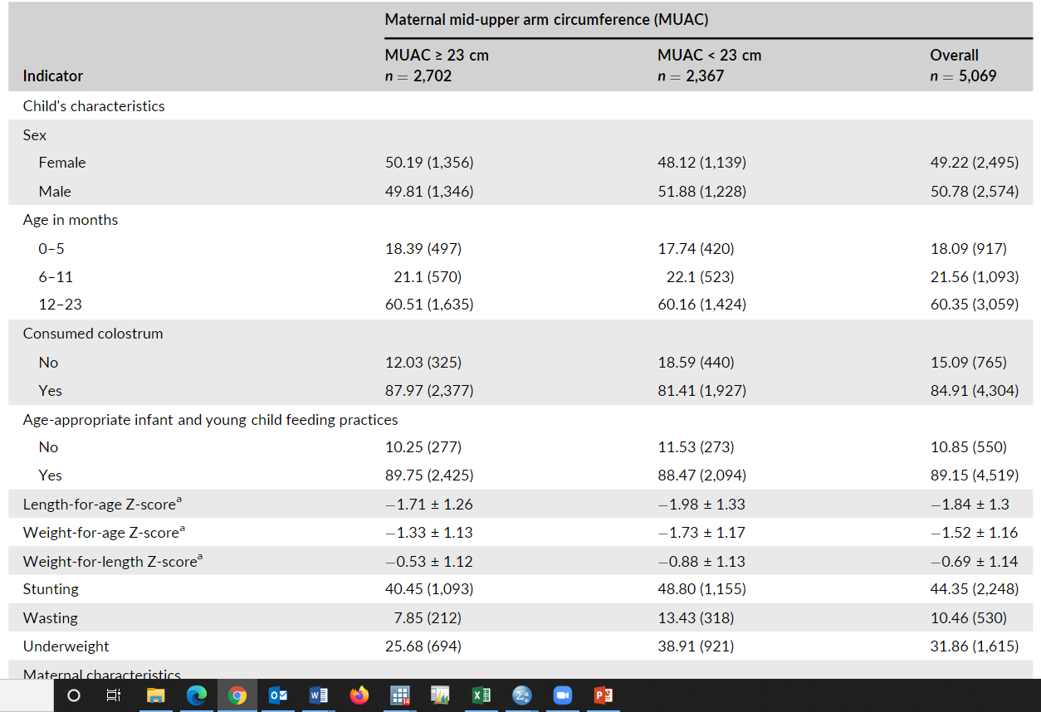

Slide 113
Outcome indicators | Incidence rate per 100 Child-months (95% CI)
 | Exposed | Unexposed | Overall
Campylobacter jejuni/coli | 48.2 (33.1, 70.3) | 36.4 (23.5, 56.4) | 42.3 (31.8, 56.3)
Clostridium difficile
EAEC!
aEPEC
tEPEC
LT-ETEC
ST-ETEC
Shigella/EIEC
Astrovirus
Sapovirus

Slide 114
Table ##. Association between exposure and pathogen infection
Pathogen | Unadjusted IRR (95% CI) | p-value | Adjusted IRR (95% CI) | p-value
Campylobacter jejuni/coli
Clostridium difficile
EAEC
aEPEC
tEPEC
LT-ETEC
ST-ETEC
Shigella/EIEC
Astrovirus
Sapovirus
Adjusted in the Poisson model for age, sex, social, occupation, BMI, SES, Hemoglobin status, BMI, ; log of total number of follow up as offset variable

